Slide 1

EEE3001 – EEE8013
State Space Analysis and Controller Design
Module Leader: Damian Giaouris BEng, BSc, PG Cert, MSc, PhD
Reader in Control of Energy Systems
Damian.Giaouris@ncl.ac.uk

Slide 2
Goals/Aims
State Space Analysis and Controller Design
Analysis (Modelling)
Controller Design
State Space

Slide 3
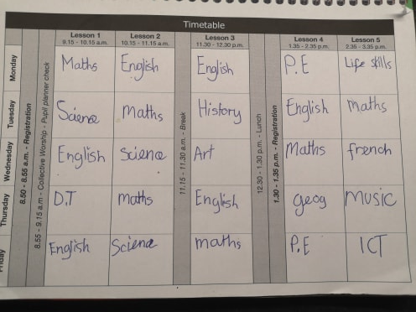
My daughter’s education – year 6

Slide 4
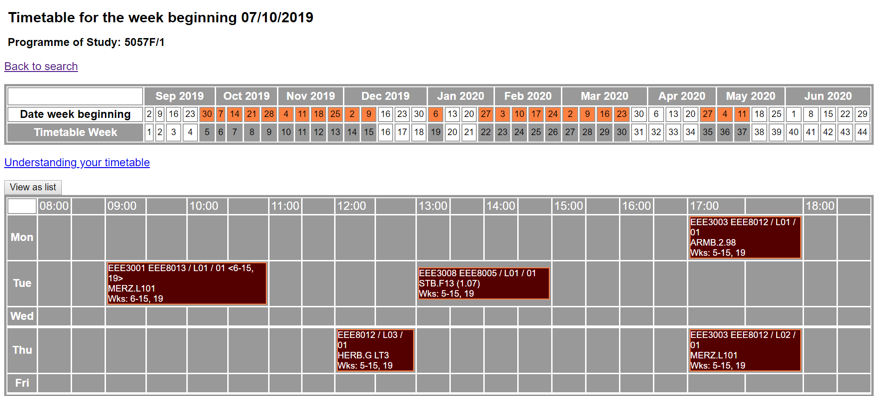
Your education – MSc A&C
So you have to do your “individual study”, i.e. go through the notes, recap recordings, library, web, group study….
Your education does NOT start and finish in the lecture theatre!!!

Slide 5
EEE8013/EEE3001
Requires good mathematical skills.
Starts assuming that most students have a light background on control theory.
Requires continuous study and work.
Does not rely only on PowerPoint presentations.
All material will be uploaded at: https://www.staff.ncl.ac.uk/damian.giaouris/teaching.html

Slide 6
Do Not Forget
There are NO stupid questions, there are ONLY stupid answers!!!!!!!!!!!

Slide 7
School of Engineering: You Said We Did
Notes:
FIXED Image / Presentation title slide.
Insert title and sub-deck as required to start your presentation.
`1234567890-=qwertyuiop[]asdfghjkl;’#\zxcvbnm,./
¬!”£$%^&*()_+QWERTYUIOP{}ASDFGHJKL:@~|ZXCVBNM<>?

Slide 8

Student Voice in the School of Engineering
You Said. We Did!!!
Every year, we ask you to provide feedback in a number of ways, including:
National surveys
Stage evaluations
Student-Staff Committees
Student representatives on School, Faculty and University committees
Focus groups and projects
We really appreciate all the feedback you provide, as this allows us to ensure that you are happy with your experience here and to make changes that will benefit you and future students.
Notes:
EDITABLE text/image slide.
To add an image, click on image icon and select from your files, or drag it into place. Please note: there are a selection of images cropped for this exact size on the University image library photo http://photolib.ncl.ac.uk/asset-bank/action/browseItems?categoryId=3578&categoryTypeId=1

Slide 9

You Said. We Did!!!
This is to let you know how feedback on this module has been considered or acted upon.
What students said about this module last year:
Average score 4.6/5, generally very positive feedback.
More examples of how to use Matlab (UG students).
Solutions/Answers to tutorial questions.
Excessive assessment (MSc students).
Specific examples.
Notes:
EDITABLE text/image slide.
To add an image, click on image icon and select from your files, or drag it into place. Please note: there are a selection of images cropped for this exact size on the University image library photo http://photolib.ncl.ac.uk/asset-bank/action/browseItems?categoryId=3578&categoryTypeId=1

Slide 10

You Said. We Did!!!
What we did in response to student feedback:
Keep the same approach.
Updated the lecture notes with more examples, symbolic toolbox commands…
Done! (but please use them wisely!!!)
Combine the two exam papers into one (I need your approval).
Not easy as we have students from various disciplines. But there are examples from various disciplines as non assessed material.
Notes:
EDITABLE text/image slide.
To add an image, click on image icon and select from your files, or drag it into place. Please note: there are a selection of images cropped for this exact size on the University image library photo http://photolib.ncl.ac.uk/asset-bank/action/browseItems?categoryId=3578&categoryTypeId=1

Slide 11
Lecture structure
Lectures are recorded using Recap: Lec6
We start every time with a brief revision of last lecture(s): Lec8
I extensively use the whiteboard which is NOT captured on Recap… so you HAVE to attend the lectures!

Slide 12
Syllabus
Ordinary differential equations
Introduction to state space (+ Observability/Controllability)
Solution of state space models
Controller design
State space transformations and Normal forms

Slide 13
Chapter 1
Ordinary Differential Equations
First Order ODEs
Second Order

Slide 14
Chapter 1 summary
To understand the properties (dynamics) of a system, we can model (represent) it using differential equations (DEs).
The response/behaviour of the system is found by solving the DEs.

Slide 15
Goals/Aims of Chapter 1
Introduction
Revision of
1st order dynamics
2nd order dynamics

Slide 16
Introduction
System: is a set of objects/elements that are connected or related to each other in such a way that they create and hence define a unity that performs a certain objective.
Control: means regulate, guide or give a command.
Task: To study, analyse and ultimately to control the system to produce a “satisfactory” performance.
Model: Ordinary Differential Equations (ODE):
Dynamics: Properties of the system, we have to solve/study the ODE.

Slide 17
Solution of 1st order ODEs

Slide 18
Analytic solution
u=0
k=2
k=5

Slide 19
Analytic solution
u=0
k=-2
k=-5

Slide 20
Analytic solution
k=5, u=0
x₀=2
x₀=5

Slide 21
Analytic solution
k=5
u=-2
u=2

Slide 22
Analytic solution
k=5

Slide 23
Second order ODEs
Second order ODEs:
So I am expecting 2 arbitrary constants
u=0 => Homogeneous ODE
Let’s try a

Slide 24
Overdamped system
Roots are real and unequal
1.5
Overall solution
1
x
2
0.5
0
x
1
-0.5
0
1
2
3
4
5
6

Slide 25
Example
A 2nd order system is given by
Find the general solution
Find the particular solution for x(0)=1, x’(0)=2
Describe the overall response

Slide 26
Critically damped system
Roots are real and equal
A=2, B=1, x(0)=1, x’(0)=0 =>
c₁=c₂=1

Slide 27
Underdamped system
Roots are complex
Underdamped system
r=a+bj
A=1, B=1, x(0)=1, x’(0)=0 => c₁=1, c₂=1/sqrt(3)

Slide 28
Undamped
Undamped system
A=0, B=1, x(0)=1, x’(0)=0 =>c₁=1, c₂=0:

Slide 29

Summary:
Basic concepts of dynamical systems.
What is a solution of an ODE.
Properties of solutions of ODEs.
Analytical solution of 1st and 2nd order linear systems.
Notes:
29

