Slide 1

EEE8072
Subsea Control and Communications Systems
Dr Damian Giaouris
Senior Lecturer in Control of Electrical Systems
damian.giaouris@ncl.ac.uk,
http://www.staff.ncl.ac.uk/damian.giaouris/

Slide 2
Introduction
System: is a set of objects/elements that are connected or related to each other in such a way that they create and hence define a unity that performs a certain objective.
Control: means regulate, guide or give a command.
Task: To study, analyse and ultimately to control the system to produce a “satisfactory” performance.
Model: Ordinary Differential Equations (ODE):
Dynamics: Properties of the system, we have to solve/study the ODE.

Slide 3
First order ODEs
First order ODEs:
Analytic:
Explicit formula for x(t) (a solution – separate variables, integrating factor)
which satisfies
INFINITE curves (for all Initial Conditions (ICs)).

Slide 4
First order linear equations
First order linear equations - (linear in x and x’)
General form:
Output
Input

Slide 5
Analytic solution
u=0, x(0)=1
k=2
k=5

Slide 6
Analytic solution
u=0, x(0)=1
k=-2
k=-5

Slide 7
Analytic solution
k=5, u=0
x₀=2
x₀=5

Slide 8
Analytic solution
k=5
u=-2
u=2

Slide 9
Analytic solution
u=1
k=2
k=5

Slide 10
Exercise
A system is given by:
Using
Predict how the system will behave for x₀=2

Slide 11
Second order ODEs
Second order ODEs:
So I am expecting 2 arbitrary constants
u=0 => Homogeneous ODE
Let’s try a

Slide 12
Overdamped system
Roots are real and unequal
1.5
Overall solution
1
x
2
0.5
0
x
1
-0.5
0
1
2
3
4
5
6

Slide 13
Example
A 2nd order system is given by
Find the general solution
Find the particular solution for x(0)=1, x’(0)=2
Describe the overall response

Slide 14
Critically damped system
Roots are real and equal
A=2, B=1, x(0)=1, x’(0)=0 =>
c₁=c₂=1

Slide 15
Underdamped system
Roots are complex
Underdamped system
r=a+bj
Theorem: If x is a complex solution to a real ODE then Re(x) and Im(x) are the real solutions of the ODE:

Slide 16
Underdamped system, example
A=1, B=1, x(0)=1, x’(0)=0 => c1=1, c2=1/sqrt(3)

Slide 17
Undamped
Undamped system
A=0, B=1, x(0)=1, x’(0)=0 =>c1=1, c2=0:

Slide 18
NonHomogeneous Case
u=0 => Homogeneous => x₁ & x₂.
Assume a particular solution of the nonhomogeneous ODE: xp
If u(t)=R=cosnt =>
Then all the solutions of the NHODE are
So we have all the previous cases for under/over/un/critically damped systems plus a constant R/B.
If complementary solution is stable then the particular solution
is called steady state.

Slide 19
Example
x(0)=1, x’(0)=0 => c1=-1, c2=-1/sqrt(3)

Slide 20
Transfer Functions
Previous analysis => Can be complicated => Polynomial expressions
Laplace Transform
Used only on LTI systems
Domain is a set of values that describe a function
The LT is transforming a DE from the time domain
to another complex domain (i.e. the variable has a real and imaginary part)

Slide 21
Transfer Functions
Use formula tables
Final Value Theorem

Slide 22
Transfer Functions
Transfer functions
The ratio of the Laplace transform of the output over the Laplace transform of the input.
Transfer function
of the system

Slide 23
Transfer Functions
But before
Exactly as the denominator of TF

Slide 24
Transfer Functions

Slide 25
Automatic Control – EEE2002

Slide 26
Block Diagram Algebra
Block diagrams
Block Diagram Algebra

Slide 27
s-plane
Pole location / s-plane
CE of ODE => Characterises the system
Den of TF = CE of ODE => CE of system
Order of ODE => Order of system
Order of Den => Order of system
The order of the ODE is 2 = order of the denominator = order of the system
=> order = 4.
What about the num?
Later…

Slide 28
Poles, Zeros…
roots of the numerator=> zeros
roots of the denominator => poles (roots of CE!!!)
Zeros:
Poles:
One zero at s=-1 and two poles at s=-2 and s=+3

Slide 29
Poles, Zeros…
roots( )
pzmap()

Slide 30
Inputs
In reality all systems have a forcing input signal (which we want to control)
We need to study these more extensively
Time domain => s domain
=> Time domain to find soln.
4 main types of inputs

Slide 31
First order systems
K=1/R and τ=L/R
Pole at -R/L
Step response

Slide 32
First order systems

Slide 33
First order systems
So 63.21% of
final value

Slide 34
First order systems
Time constant: How fast is the system
Faster system
The smaller the time constant
The faster the system
The further the pole is in the left hand side

Slide 35
Second order systems

Slide 36
Second order systems
Case 1:
Transient
Steady state

Slide 37
Second order systems
Hence the component with s₁ will converge very fast to 0
Example: z=1.5, wn=2rad/s

Slide 38
Second order systems
Example: z=1, wn=2rad/s

Slide 39
Second order systems
The line between the origin and the pole is:
r=a+bj

Slide 40
Second order systems

Slide 41
Second order systems

Slide 42
Second order systems

Slide 43
Second order systems
Example: z=0.5, wn=2rad/s

Slide 44
Second order systems
The system is called marginally stable because the solutions
do not diverge to infinity
Example: z=0, wn=2rad/s

Slide 45
Second order systems

Slide 46
Second order systems
Example: z=-0.5, wn=2rad/s

Slide 47
Second order systems

Slide 48
Second order systems in s-plane

Slide 49
Time Domain Characteristics

Slide 50
Extra Poles
n>m for a real system
i.e. combination of first and second order systems

Slide 51
Extra Poles
The response of a higher order system is the sum of exponential and damped sinusoidal curves.
Assuming that all poles are at the left hand side then the final value of the output is “1” since all exponential terms will converge to 0.
Let’s assume that some poles have real parts that are far away from the imaginary axis=>

Slide 52
Extra Poles
Overall performance is characterised by the isolated
(far away from zeros) poles that are close to the imaginary axis.
If we have only one pole (or a pair for complex roots) that is closed to the real axis then we say that this pole (or pair of poles) is (are) the DOMINANT pole(s) for the system.
A simple rule is that the dominant poles must be at least five to ten times closer to the imaginary axis than the other ones.
The values of b (numerator coefficients) determine the amplitude of the oscillations of the system but not its stability properties.

Slide 53
Extra Poles
A system has two poles at -1 and -2, and two complex poles at -10+/-40j (num=1)
Find the damping factors and natural frequencies of the system
Do you expect the system to have oscillations?
Find the step response of the system.
Approximate the system by using two dominant poles.
Find the new step response, natural frequency and damping factor.
Compare that response with the response of the original system.
Repeat the previous exercise by assuming that the second set of poles is at
-0.5+/-1.5j.
At the system with the two poles at -0.5+/-1.5j add two zeros at -0.51+/-1.51j.

Slide 54
Closed loop systems
The input to the system sees the output: Feedback
This is a CLOSED LOOP system.

Slide 55
General closed loop systems
Gc= TF of controller
G TF of plant
Open Loop (OL) TF
Negative feedback

Slide 56
General closed loop systems
Our Task: DESIGN Gc and H (if applicable).
Assume H=1 and Gc=K=const.
We can influence
Steady state
Transient
If K>>R then Css=1
faster system.

Slide 57
General closed loop systems

Slide 58
Summary
1st order systems with feedback.
the steady state and the time constant.
We moved the pole further into “minus infinity” area.
Hence we changed the s-plane of the system.
What is it going to happen if we use a 2nd order system???

Slide 59
2nd order systems
Faster system
Smaller steady state error
Oscillations!

Slide 60
2nd order systems
CE:
CE:

Slide 61
3rd order systems
The feedback and the controller
can completely change the location of the poles in the s-plane.
Step response for K=1, 10 & 100

Slide 62
Summary
Properties of feedback systems:
Minimise steady state error.
Faster system.
Less sensitive to system uncertainties.
Introduce instability (even for negative feedback).
Expensive (we need to feedback the signal, i.e. use a sensor).

Slide 63
PI control
Steady state error problem
INCREASE K => INCREASE the oscillations=>instability
K=10

Slide 64
PI control
Notes:
64

Slide 65
PI control
Notes:
65

Slide 66
PI control
Notes:
66

Slide 67
PI control
Notes:
67

Slide 68
PI control
Notes:
68

Slide 69
Tuning of PID controllers
Trial and error.
Ziegler Nichols I
Ziegler Nichols II
Root locus
Frequency response
Other advanced control methods

Slide 70
Tuning of PID controllers
Trial and error
P: Faster system, in some cases reduces the error (can cause instability).
I: Reduces the steady state error, increases the number of oscillations.
D: Reduces the oscillations.
Ziegler Nichols I

Slide 71
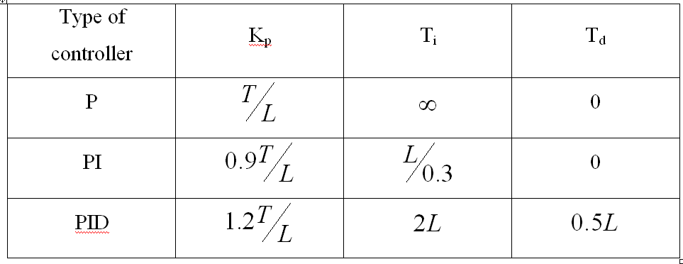
Tuning of PID controllers
Ziegler Nichols I

Slide 72
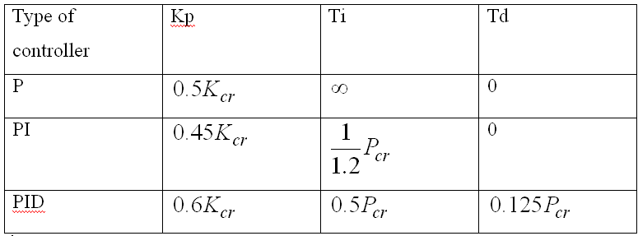
Tuning of PID controllers
Ziegler Nichols II
Initially assume K_{i}=K_{d}=0.
Kp=Kcr

Slide 73
Tuning of PID controllers
Root Locus
Target a pole location
This is a 3rd order system = 2nd order x 1st order:

Slide 74
Other controllers - 1

Slide 75
Other controllers - 2
Unity feedback and input: r(t)=5t
a) If K=1.5, find the steady state error
b) The system must have steady state error, Ess<0.1 find the value of K
a)
b)

Slide 76
Other controllers - 3
a) Find the value of K such as the system is marginally stable
b) Find the frequency of oscillations at that point
For marginally stable system:

Slide 77
Other controllers - 4
The control system of a space telescope
The targeting system must have
zero steady state error when
the targeting angle is 0.01º
Overshoot of 5%
Calculate the characteristic equation.
Find the closed loop poles and zeros.
Find the gains K1 and K2.
Determine the maximum allowed velocity of objects that the telescope can follow if the steady state error should not be greater than 0.5º/s. The objects are assumed to move with a constant velocity of Aº/s.

Slide 78
Other controllers - 4
Calculate the characteristic equation.
Find the closed loop poles and zeros.
No zeros
Find the gains K1 and K2.
The targeting system must have zero steady state error when the targeting angle is 0.01º
r=0.01
R=0.01/s
C_{ss} = 0.01
Overshoot of 5%
A=0.5

Slide 79
Other controllers - 5
Block diagram of a servo unit
Find the closed loop transfer function.
Create the block diagram of the closed loop system
Find the characteristic equation of the closed loop.
Prove that when K is constant the steady state error will increase if
is increased.
Find the values of K and
so that the system has a maximum overshoot of 40% and a peak time of 1s.

Slide 80
Other controllers - 6

