Slide 1
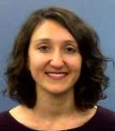
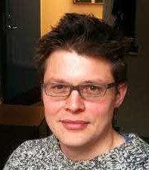
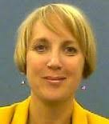
Teachers’ perceptions of Machine Translation as a pedagogical tool
British Association of Applied Linguistics, Northumbria University, 10th Sep 2020
Nick Riches, Elaine Lopez, Müge Satar Cohen, Saziye Tasmedir, Newcastle University
Project funded by AHRC Creative Multilingualism, via University of Oxford, grant RES/0352/7290

Slide 2
The situation

Slide 3
Pedagogical objections to translation and MT
Negative view of translation
To achieve proficiency we must “think” in the target language
Translation often leads to errors, e.g. he’s educated, she weared herself a dress.
Negative view of translation technology
It can be used to cheat, e.g. in written tests.
It leads to passivity.

Slide 4
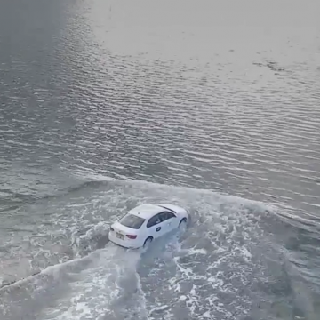
Beating the tide?
“while in the classroom the teachers try to keep the two languages separate, the learners in their own minds keep the two in contact” (Widdowson, 2003, p. 150, as cited by Cook, 2007).
L2 learners “instinctively” translate during writing tasks (Cohen et al. 2000)

Slide 5
Neural integration of different languages
When we are exposed to more than one language the human mind ”naturally” integrates them, e.g.
Interference errors
RT data for naming tasks (Costa et al. 1999)

Slide 6
Advantages of translation
Given initial learners’ dependency on translation we should teach when translation is / is not a viable strategy
In the lexical domain, many teachers already do this, e.g. by highlighting “false friends” (SP. educado -> ENG. polite)
Why not in the syntactic domain?
Translation as a means of fostering intercultural awareness (Machida, 2011)
Translation as a means of fostering metalinguistic abilities

Slide 7
Learners versus teacher’s views of MT
Learners value MT for
(a) vocabulary expansion and
(b) writing (Clifford et al., 2013; Niño, 2009; Lee, 2020)
Teachers are generally suspicious of MT due to
(a) Threats to academic integrity
(b) Threats to student motivation
(c) Undermining classroom activity (Clifford et al., 2013; Crossley, 2018; Ducar & Schocket, 2018; Lee, 2020)

Slide 8
Active engagement with MT is vital (Ducar & Shocket, 2018)
We cannot “google-proof” classrooms
Teachers need to directly engage with MT
Make classroom “google irrelevant”
Teach students about advantages and disadvantages of MT

Slide 9
Aims of the study
Proof of concept study
Feasibility / utility of a translation app with a focus on structure
Explore teachers attitudes towards this app

Slide 10
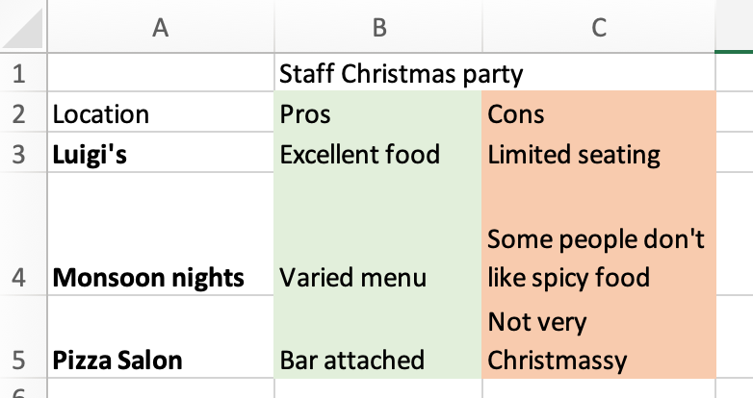
The social construction of technology (Kline & Pinch, 1996)
Technologies designed for one use are quickly adapted by communities of interest to serve other purposes.
A technology may “technically” be very useful, but will not be successful unless it is consistent with the aims and values of relevant communities.

Slide 11
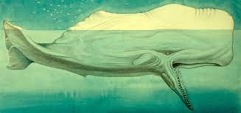
Commercial / Propietary
Moby Dick, Herman Melville
Free / open source (but charges for hosting)

Slide 13
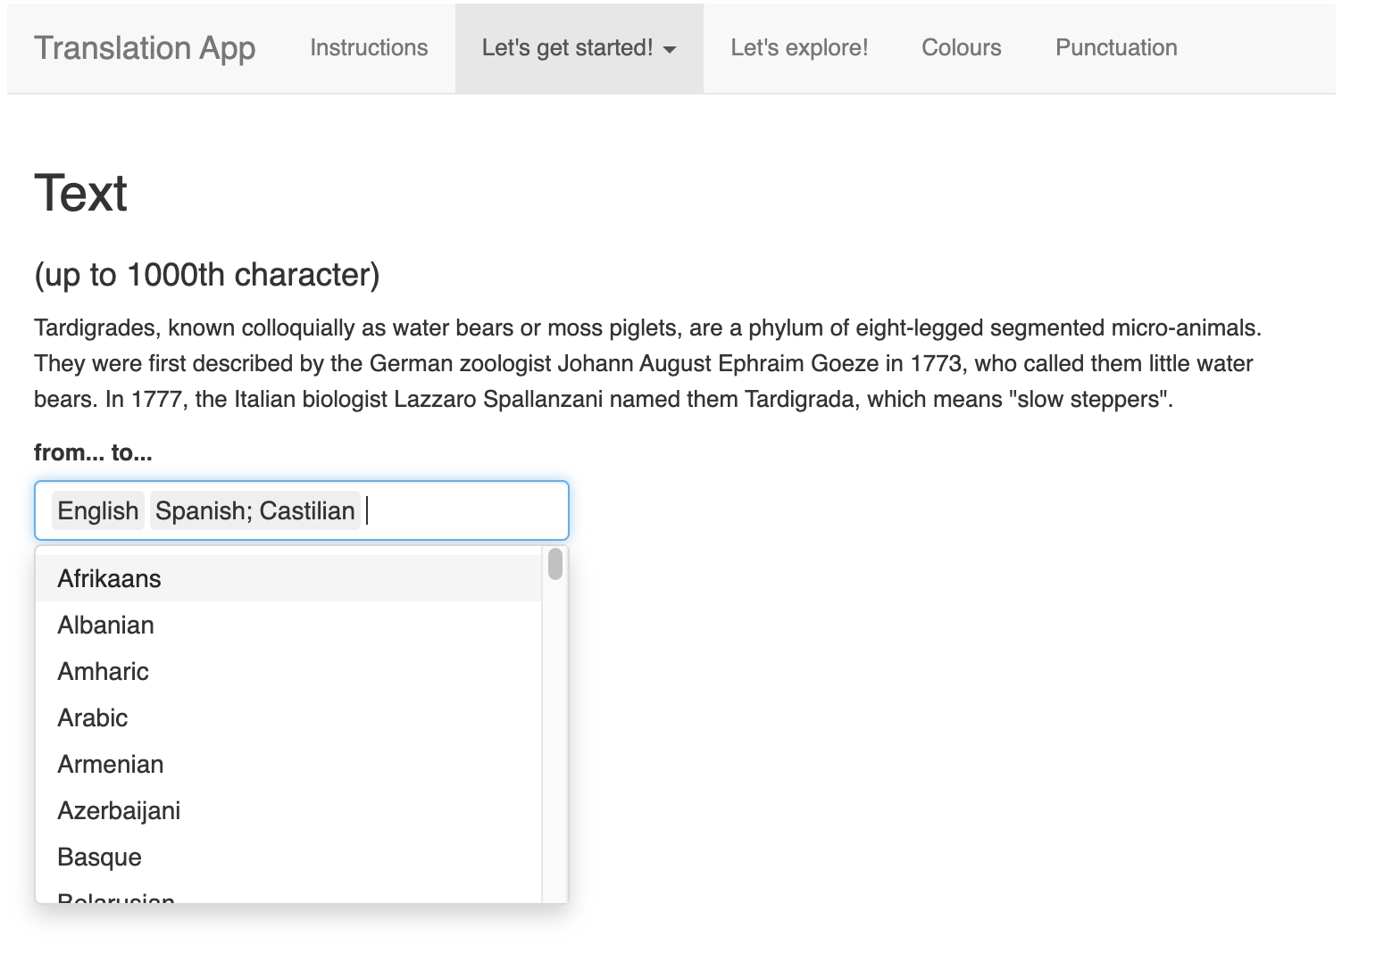

Slide 14
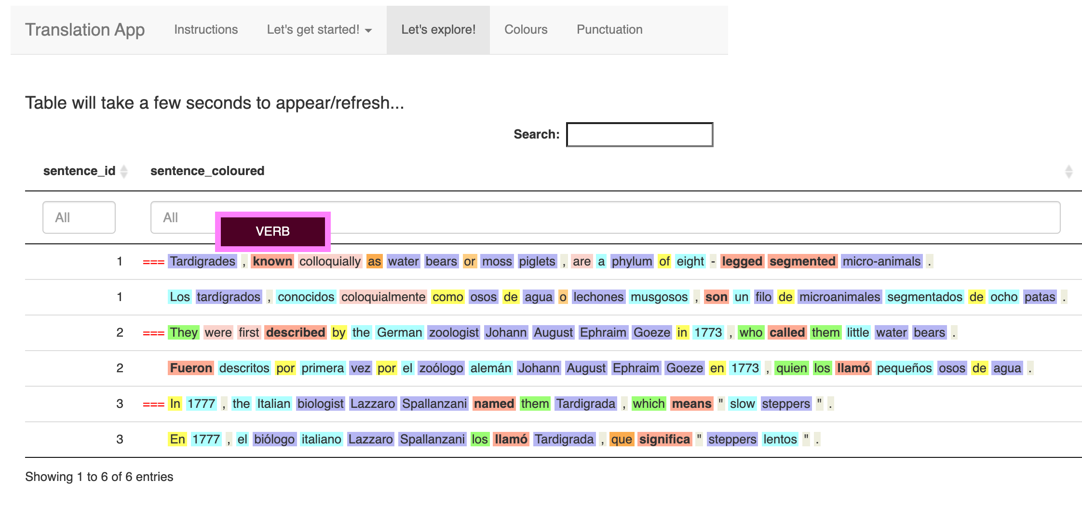

Slide 15
Participants
Pseudonyms | School | Languages/courses taught | Age group taught
Sophie | Secondary school | GSCE French GSCE German | 11-16
Natalie | Community school | Greek | Adults
Emma | Middle school | French Spanish | 9-13
Barbara | Middle school | French Spanish | 9-13

Slide 16
Focus group details
Transcription via Nvivo following Braun and Clarke’s (2006) six phase inductive thematic procedure
Focus group began with a general discussion of translation and MT in the classroom
App was introduced part-way through

Slide 17
Barriers to MT adoption in language teaching
Access to MT | Students’ misuse | Negative attitudes towards accuracy of MT
Safeguarding / IT security – militates against a “blended” approach / use of IT becomes logistically complex | - “Reliant on it” / “Not really working”. - Inaccurate, poor translations could lead to fossilisation of the L2 | No sensitivity to register Language variety

Slide 18
Motivations towards MT adoption in language teaching
Role of technology in language teaching | Role of translation in language pedagogy | Attitudes towards accuracy of MT
interactive whiteboards to be “indispensable” “I don’t think I’ve used a textbook for years. I don’t think they [students] expect it” Provides “immediacy”. ”Anything that sort of hooks them in” But logistically difficult, and no substitute for one-to-one interaction | Translation in the curriculum. Useful for teaching sentence structure + improve fluency through chunk translation Understanding of metalanguage (L1 -> L2 -> L3). Sympathetic towards idea of learning structure from translation. “Dodgy translation” e.g. I have the hairs blond. Perception that translation had increased competence and fluency | Translation accurate Helping children from diverse L1 backgrounds Greater metalinguistic awareness, e.g. changing parts of sentence and observing how this affects translation. But use needs to be highly supervised

Slide 19
Feasibility of adopting the MT web app, Transpose, in teaching
Existing functionality | Desired functionality | Preferred method of use | Extended use
- Helpful for demonstrating sentence structure. - Ability to translate from non-English L1 possibly useful for individuals with EAL | Ability to search for a single word class / choose colours, since multiple colours can appear confusing (Sophie) the ability to save bespoke colour schemes, designed by the teacher, across sessions comparison of more than two languages particularly for multilingual students (Barbara) | more suitable for students with comparatively higher-levels of language Lower-level users may lack metalanguage / experience cognitive overload | degree-level students EAL / ESOL contexts Teachers (to learn new language / check their linguistic knowledge)

Slide 20
Conclusions
Generally positive attitude towards role of (MT) translation, including at the sentence level. Possibly motivated by changes in the national curriculum
Generally positive attitude towards use of technology, though recognition of difficulties integrating with classroom practice – perhaps MT best for personal study?
Numerous suggestions incorporated into app, especially (a) translation to multiple languages (to help EAL individuals), (b) customization of colour schemes

Slide 21
Conclusions
Not suitable within a school classroom context, but may be well-suited to personal study
Possible benefits for higher-level students studying autonomously
NEXT STEPS
Possible application to higher education environment

Slide 22
Cook, G. (2007). A thing of the future: Translation in language learning. International Journal of Applied Linguistics, 17(3), 396–401. https://doi.org/10.1111/j.1473-4192.2007.00160.x
Cohen, A. D., Brooks-Carson, A. W., & Jacobs-Cassuto, M. (2000). Direct vs. translated writing: What students do and the strategies they use. University of Minnesota. Center for Interdisciplinary Studies of Writing.
Costa, A., Miozzo, M., & Caramazza, A. (1999). Lexical selection in bilinguals: Do words in the bilingual’s two lexicons compete for selection? Journal of Memory and Language, 41, 365–397.
Machida, S. (2011). Translation in Teaching a Foreign (Second) Language: A Methodological Perspective. Journal of Language Teaching & Research, 2(4).
Clifford, J., Merschel, L., & Munné, J. (2013). Surveying the Landscape: What is the Role of Machine Translation in Language Learning? @tic. Revista d’innovació Educativa, 0(10), 108–121. https://doi.org/10.7203/attic.10.2228
Niño, A. (2009). Machine translation in foreign language learning: Language learners’ and tutors’ perceptions of its advantages and disadvantages. ReCALL, 21(2), 241–258. https://doi.org/10.1017/S0958344009000172
Lee, S.-M. (2020). The impact of using machine translation on EFL students’ writing. Computer Assisted Language Learning, 33(3), 157–175. https://doi.org/10.1080/09588221.2018.1553186
Ducar, C., & Schocket, D. H. (2018). Machine translation and the L2 classroom: Pedagogical solutions for making peace with Google translate. Foreign Language Annals, 51(4), 779–795. https://doi.org/10.1111/flan.12366
Kline, R., & Pinch, T. (1996). Users as Agents of Technological Change: The Social Construction of the Automobile in the Rural United States. Technology and Culture, 37(4), 763–795. https://doi.org/10.2307/3107097

