Slide 1
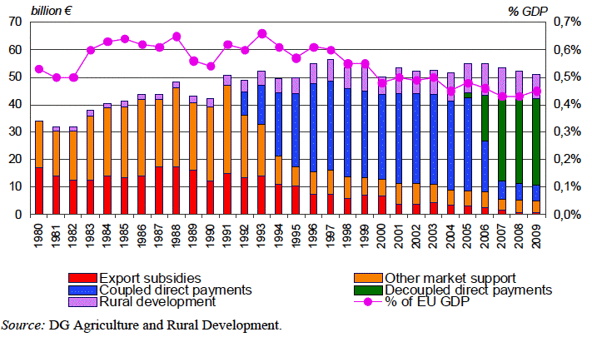
Policy History
CAP has become ‘more competitive’ (WTO rules)
Source: DGAgri CapReform Impact Assessment, 2011
Notes:
EC 2011 – P 12. Export subsidies and market support are WTO anti-competitive; Decoupled direct payments are ‘acceptably competitive’ – removing more is going to be difficult.

Slide 2
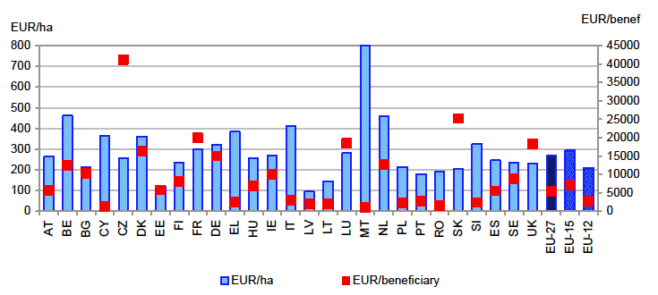
INTER MS COMPETITION?
Present EU SFP clearly NOT ‘competitive’ – not a ‘level playing field’
Notes:
EC, 2011, p29. “This figure is based on the national envelopes of Member States after full phasing-in of direct payments in the EU-12 and the number of potentially eligible hectares in IACS for 2008.” – AND has been even worse pre 2013, since NMS (the 12) have not been fully supported through the EU budget for these payments.

Slide 3
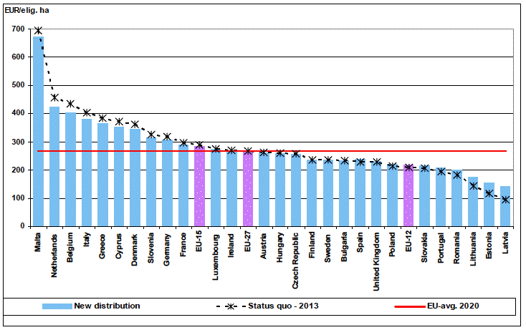
INTER MS COMPETITION?
Proposed ‘reform’ very little better:
Notes:
EC, 2011, P60

Slide 4
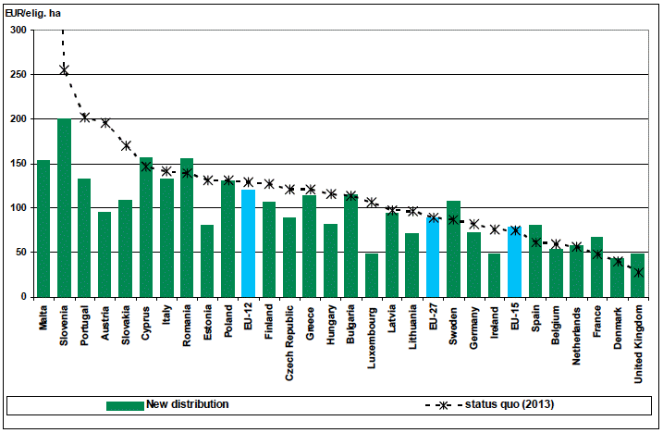
INTER MS COMPETITION?
What would an “objective” distribution be?
Notes:
EC, 2011, P60/1 : “A distribution based on a formula that takes into account the competitiveness of the agricultural sector (e.g. agricultural area, labour force and labour productivity), climate change and the environment (e.g. agricultural area, Natura 2000, LFA, forest and permanent pasture areas), and balanced territorial development (e.g. rural population) would improve the effective support by enhancing its fit to the declared objectives of the policy. It would then be calibrated by a cohesion factor GDP/capita in PPS (the lower the GDP in the Member States, the higher the Member State envelope). [A possible formula taking into account the three elements equally would be: [1/3 [(1/2 Area + ½ Labour) x labour productivity inverse index] + 1/3 (1/3 Area + 1/3 Natura 2000 + 1/6 Forest + 1/6 Permanent pasture) + 1/3 Rural population] x GDP inverse index]
BUT THIS IS COMPLETELY INCONSISTENT WITH ANY MAJORITY VOTE IN THE COUNCIL – TO SAY NOTHING OF THE PARLIAMENT – and could only be made so, with a very substantial increase in budget to Agriculture.

Slide 5
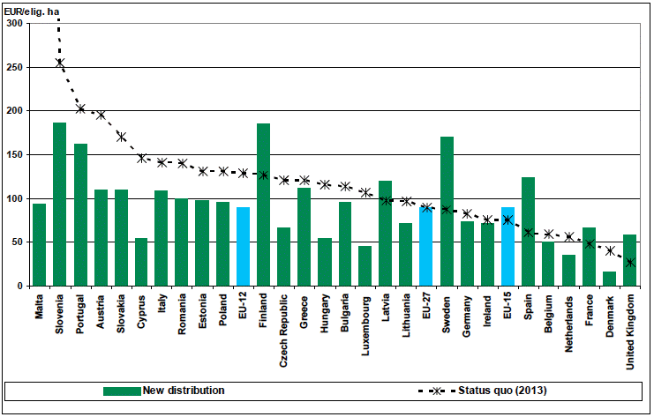
INTER MS COMPETITION?
What would a “Green” distribution be (Re-focus)?
Notes:
EC, 2011, P74: Refocus on environmental targeting: “The scenario would also imply a major redistribution of rural development funds based on the environmental criteria (agricultural area, Natura 2000 area, forest and permanent pasture) - (1/3 Area + 1/3 Natura 2000 + 1/6 Forest + 1/6 Permanent pasture) x GDP inverse index)
BUT THIS IS COMPLETELY INCONSISTENT WITH ANY MAJORITY VOTE IN THE COUNCIL – TO SAY NOTHING OF THE PARLIAMENT

Slide 6
Green?
DP/ha v. Natura 2000 % UAA? Correlation: -0.075; [with land of ‘high nature value’, -0.14] – rewards, or incentives?

Slide 7
Better Targeted (1)?
DP with GVA? Correlation: +0.5, in the ‘wrong’ direction! Reduced to +0.08 if DPs deducted from GVA

Slide 8
Better Targeted (2)?
DP with Ag income Gap? Correlation: +0.2, but clearly dominated by an outlier (Lu)

Slide 9
Back to Basics – the ‘Canute’ problem part 1
ECONOMICS: Farming is textbook ‘competitive’,
[except that it isn’t - differentiated products, transaction costs, concentrated suppliers and buyers, ‘peasant’ household firms, highly heterogeneous factors, imperfect knowledge, externalities etc.]
BUT Competition => zero pure profits, and accumulation of rents in factor (land) prices, and increased costs,
& economic growth => declining “farm” sector
Maintaining Competitiveness requires adjustment, adaptation and innovation to the ‘tides’ of (free) markets.
=> decouple, and eliminate support -> target assistance for public goods & market failures; support R&D & Extension; enforce competition rules.
Notes:
King Canute thought he was powerful enough to halt the incoming tide: “that with the greatest vigor he commanded that his chair should be set on the shore, when the tide began to rise. And then he spoke to the rising sea saying “You are part of my dominion, and the ground that I am seated upon is mine, nor has anyone disobeyed my orders with impunity. Therefore, I order you not to rise onto my land, nor to wet the clothes or body of your Lord”. But the sea carried on rising as usual without any reverence for his person, and soaked his feet and legs. Then he moving away said: “All the inhabitants of the world should know that the power of kings is vain and trivial, and that none is worthy the name of king but He whose command the heaven, earth and sea obey by eternal laws”. Therefore King Cnut never afterwards placed the crown on his head, but above a picture of the Lord nailed to the cross, turning it forever into a means to praise God, the great king. By whose mercy may the soul of King Cnut enjoy peace.” ((Henry of Huntingdon, Chronicle)

Slide 10
Back to Basics – the ‘Canute’ problem part 2
POLITICS: - dominated by status quo – resist or ameliorate change, protect vested interests, support the disadvantaged, respond to votes:
to help the uncompetitive survive and persist (be more competitive) – especially the numerous small, the disadvantaged – against unjust markets, oligopolistic suppliers and buyers & ‘less favoured’ environments;
Political Forces more powerful the greater the number of small (uncompetitive) farms; the faster non-farm economic growth; the bigger the farm sector; the greater the dependency (in supply chains & bureaucracies, as well as among farms)
= retain & justify historic support, limited to ‘deserving’ and justified ‘public/merit’ goods & services arguments (which fail)

Slide 11
POLICY CONCLUSIONS
RESULT – Political failure dominates, recruits “market failure” as justification for continued support – which fails to deliver.
CAP ‘reform’ very limited (as now) until there is a ‘perfect storm’ (as 1994, 2003)
CAP inherently retards economic competitiveness, while trying (in vain) to retain political/public competitiveness -> greater complexity
When and what will drive further reform?
Euro disaster?
Continual ‘drip’ of economic reason to erode political rationality?
Continual failure of ‘support’ to deliver? -> recognition by farm lobbies that they are incapable of retaining ‘their’ support?
Will it go with a bang, or with a whimper?

