Slide 1
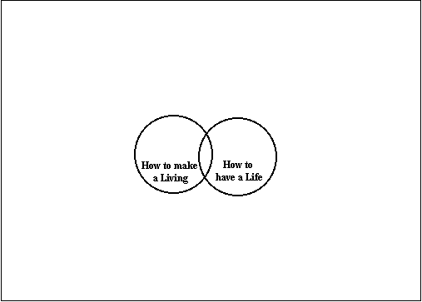
WHAT DOES ECONOMICS DO?
Notes:
We need to re-assess the fundamental capabilities and distinctive advantages offered by economics (Kay, 1993). Even more importantly, we need to be much more careful about how we represent economics within a more general systems of social behaviour, so that most people can find and live with a sensible position on the spectrum between those (few) who think economics is all that matters and those, apparently richer, possibly more thoughtful, and rather more numerous, who think it shouldn’t matter so much.
The essence of economics is the balance between how to make a living and how to have a life - the balance between supply and demand

Slide 2
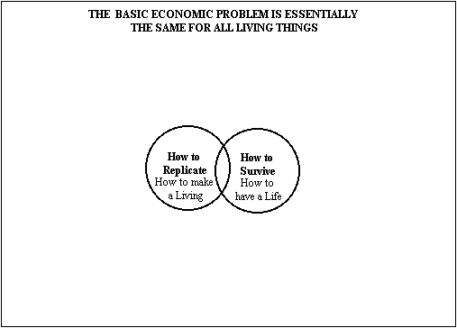
WHAT DOES ECONOMICS DO?
Notes:
Which is essentially the same problem as for all living things - the twin problems of how to survive and how to replicate. In other words, human systems evolve, as do their natural ancestors.
As Winter,1988, notes: “natural selection and evolution should not be viewed as concepts developed for the specific purposes of biology and possibly appropriable for the specific purposes of economics, but rather as elements of the framework of a new conceptual structure that biology, economics and the other social sciences can comfortably share.” (p 614).
It has since been pointed out to me that Herbert Spencer, the Quaker philosopher of the 19th century, could be regarded as a founder of this basic idea (although it has antecedents in Adam Smith). However, as far as I can see, he did not discern the key difference between natural and social evolution.
See http://www.iep.utm.edu/spencer/ for Herbert Spencer>

Slide 3
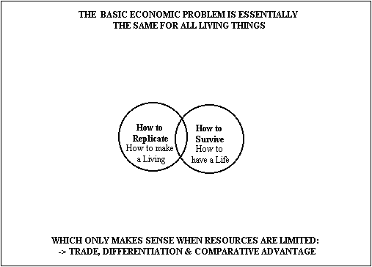
WHAT DOES ECONOMICS DO?
Notes:
These choices - which are always treated as anthropomorphic in economics, but seldom in ecology - only make sense when resources are limited - and generate the enormously powerful concepts of trade, specialisation, comparative advantage and opportunity cost as a result.
The proposition that economic systems are evolutionary(Winter - Palgrave Dictionary of Economics) casts a rather different light on the conventional economic notion of competition. The correspondence between natural selection and competitive economic behaviour is well recognized in the joint development of ecological and economic models. Both explain how natural systems, which do not care, nevertheless contrive to be prudent by default - Adam Smith’s invisible hand in a nutshell. Treated as well-defined games, there is one optimum strategy. Both natural ecologies and competitive economies end up minimising purposive effort to best effect - by innovating better fits with a local environment that is partly their own making. Human economies might use more sophisticated tools, and appear to follow human rules, but the motives are essentially animal – survival and growth (consumption) and replication (income and profit, providing the wherewithal to continue growing).

Slide 4
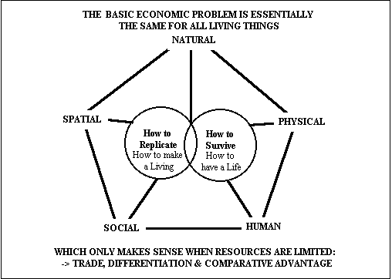
WHAT DOES ECONOMICS DO?
Notes:
We can picture the limited, finite resources (or ‘capitals’) as currently defined in the Sustainable Livelihoods framework now adopted by DfID, except that I prefer the identification of spatial capital (as the history or context and circumstance of where people and their resources are located) rather than the DfDI definition of financial capital - which is merely the means by which other capitals are transformed into flows of services and hence into each other.
Even the basic evolutionary strategies are the same – in conditions of uncertainty, breed as fast and prolifically as possible and take no care of the offspring; in more secure conditions, limited reproduction and family care make more sense.
This representation has two very important implications:
The richer are economies (however spatially defined) the more niches and the more species (communities) we can expect to find - the common idea that niche marketing can only occupy the periphery of an economy rather than its core maybe fundamentally misplaced - the whole of richer economies could be, even should be, made up of interlocking niches. Successful (and sustainable) economies, and ecologies, are niches all the way down. The climax condition of the naturally (rather than perfectly) competitive economy is monopolistic competition. The apparent inefficiency of this market structure is merely an indication of the price we are willing to pay for being different, and being able to explore our individuality within the natural constraints of competition. Level playing fields are not where it’s at. Marketing, with its emphasis on market segmentation and product differentiation is thus a natural extension of our primitive economic conceptions.
The so-called behavioural equations which economists use to formalise this competition are NOT structural relationships - they are REDUCED FORMS, simply expressing the necessary conditions which are required to hold for a competitive (pareto optimal) equilibrium allocation of resources - see, especially, Makowski and Ostroy, 2001. To pretend otherwise does economics no favours, and we should stop doing it.

Slide 5
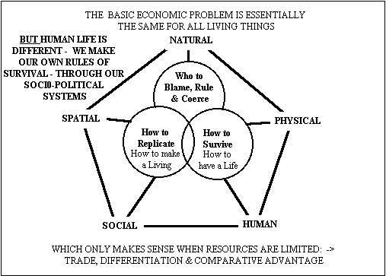
WHAT DOES ECONOMICS DO?
Notes:
But, human life is much more than simple animal survival and natural selection. The world of perfect competition is indeed nasty, brutish and short, as marketing professionals and strategic business planners well know, and policy analysts and applied economists forget at their peril. Even so (viewing the competitive market as naturally competitive rather than perfectly competitive), there is no guarantee that the Pareto optimal outcome will be regarded as SOCIALLY optimum
But 1 - who chooses? Consumers, on the basis of income and wealth - the distribution of resources. Consumption is all. The poor have little choice, and the rich too much to be sensible.
Resources (wealth) becomes concentrated - accidents of innovation, timing and birth, aggravated by capitalism (as opposed to free markets) where trading capital stocks leads to shaving margins from the transfers.
But 2 - the poor will do something about it, and the rich recognise that they will and do just enough to prevent the poor from doing too much.
So we try to make our own rules about who lives and who dies - who gets to benefit and who is taxed on their benefits - rather than leave these decisions to the natural laws of survival of the fittest. The long arm of the law is necessarily attached to Adam Smith’s invisible hand, if only to outlaw theft, establish and protect property rights, and enforce contracts. This is the essence of human free will - it is useless to search for this within a single human mind.
Governance is endogenous in the social evolutionary system. We evolve governance structures to make our collective decisions - which we typically call politics.

Slide 6
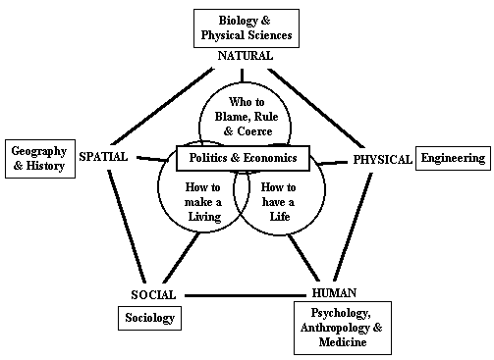
WHAT DOES ECONOMICS DO?
Tools are important,
but rules are critical
Notes:
This representation provides a structure to social and natural sciences as they are employed in the pursuit of human happiness. It is my first answer to the question of the title. This is one representation of how economics fits - the structures we observe.
But it does NOT provide many clues as to how these structures are changed - of how the adapt, adjust and evolve through time. It tells us nothing about the processes.
Our institutions, the social codes, realities and authorities (North, 1990), are the manifestations of the ways we choose to do this – our governance structures. These are, however, also subject to continual competition with each other, and thus subject to re-invention and adaptation in a blind pursuit of better fits. Social science, if it is to make any difference, must be focused on providing insight to this blind pursuit. How might social science more profitably pursue this ambition?
It is the rules (codes, norms, habits of behaviour, constitutions, rulers, governments etc) which make the real difference between natural and social evolution.

Slide 7
But – the key to the future depends on how we shape, accumulate, or abuse our five principal ‘capitals’
through our ‘capital’ and ‘finance’ markets
Survival of the fattest, rather than the fittest?
Kings make wars, the rich get the pleasure ……?

