Slide 1



A Bayesian network approach incorporating imputation of missing data allows exploration of complex causal biological relationships between variables associated with type 2 diabetes
Heather J. Cordell and Richard Howey
Population Health Sciences Institute/Research Software Engineering Team, Newcastle University, UK

Slide 2
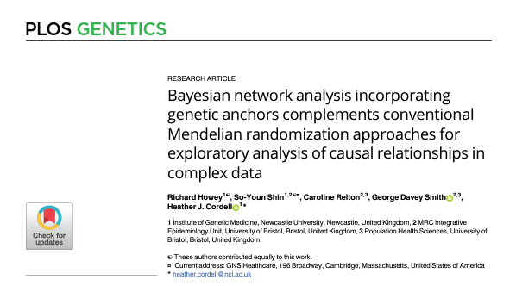

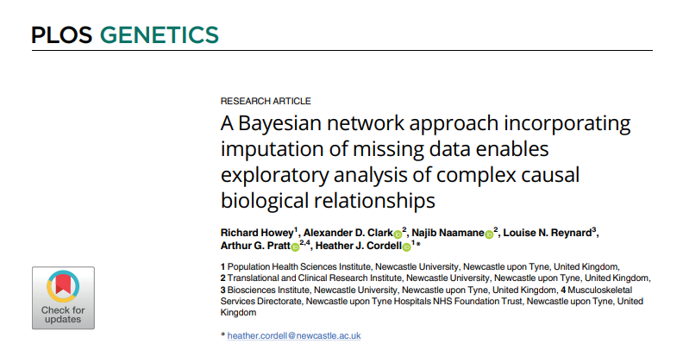
Further reading

Slide 3
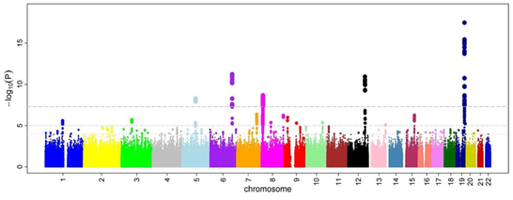
Genome-Wide Association Studies
Genome-wide association studies have identified many genetic variants (usually single nucleotide polymorphisms, SNPs) associated with disease phenotypes…
Data consists of a vector x of 500,000 - 4 million predictor variables (coding for genotype at each measured SNP)
Genotype at SNP i | x_{i}
A/A | 0
A/C | 1
C/C | 2

Slide 4
Next Step after Genome-Wide Association Studies
There is increasing interest in exploring the mechanism behind these associations using causal modelling techniques
Including approaches based on Mendelian Randomisation (MR)
Enabled by the fact that SNPs can be considered as genetic instruments/causal anchors which are assigned at birth
SNP
Gene Expression
Phenotype

Slide 5
Next Step after Genome-Wide Association Studies
Causal modelling with many variables:
A
B
SNP1
X
Phenotype 1
SNP2
Y
Phenotype 2
C
D

Slide 6
Bayesian Networks
Z
Z
A
Y
A
B
C
Y
B
C
With the use of Bayesian networks, many variables can be modelled simultaneously in an exploratory manner.

Slide 7
Bayesian Networks
A BN comprises a Directed Acyclic Graph (DAG), with an accompanying probability distribution
Modelling the distribution of the child nodes (variables), conditional on their parent nodes
Given data, we can calculate a score (typically based on the likelihood, or a function of the likelihood, e.g. AIC or BIC) representing how well any particular network fits the data.
Can search through network space to find the best-fit network, or else use a bootstrapping (with replacement) technique to calculate the average best-fit network
Averaging over the best fit network obtained from each bootstrap sample of the data

Slide 8
BNs and causality
It has recently become popular to emphasize that, strictly speaking, BNs are defined purely in terms of their encoding of conditional independence relationships between variables
Without any implication that these should represent causal relationships
A Bayesian network can be considered to be “nothing more than a compact representation of a huge probability table”
[Pearl J, Mackenzie D. The Book of Why. Penguin Books; 2018]

Slide 9
BNs and causality
However, it is not clear that this is how they were originally envisaged…
“Bayes Networks are directed acyclic graphs in which the nodes represent propositions (or variables), the arcs signify the existence of direct causal influences between the linked propositions” [Pearl, 1985]
“a Bayesian network is a directed acyclic graph whose arrows represent causal influences or class-property relationships” [Pearl, 1988]
“Bayesian networks are DAGs in which the nodes represent variables, the arcs signify the existence of direct causal influences between the linked variables” [Pearl, 1988]
“in practice, Bayesian networks are typically constructed using notions of cause and effect” [Heckerman et al. 1995]
“learning a network structure is useful, because we can sometimes use structure to infer causal relationships in a domain, and consequently predict the effects of interventions” [Heckerman et al. 1995]
“The direction of the edges is usually interpreted as a causal relationship between the two variables” [Di Zio et al. 2014]

Slide 10
BNs and causality
We argue that the difference between an acausal and a causal BN is in the meaning and interpretation ascribed to it
In an acausal BN, the directed arcs or arrows between variables represent purely conditional independence relationships
In a causal BN they represent direct functional relationships among the corresponding variables [Pearl, 2009]
Such that an intervention on (or manipulation of) the value of a parent variable will result in a corresponding change in the probability distribution of a child variable
Note that this idea of the probability distribution for one variable being determined by (or “responsive to”) the value of another variable differs from the concept of individual-level chains of causation
Which can be potentially identified using methods that operate on more general causal diagrams, such as structural causal models [Pearl J, Mackenzie D. The Book of Why. Penguin Books; 2018]

Slide 11
BNs and causality
Our view is that, since a causal diagram implies a set of probabilistic relationships, and a BN encodes a set of probabilistic relationships…
…the search for BNs that are well-supported by observed data can also be considered as a search for potential causal relationships that are well- supported by the observed data.

Slide 12
Technical assumptions (required to use samples from probability distributions to make valid causal inferences)
Causal Markov assumption
A variable is independent of all other variables, except for its descendant nodes, conditional on its parent nodes
Causal faithfulness assumption
The network structure and the causal Markov relations assumed represent all (and the only existing) conditional independence relationships among variables
Causal sufficiency (follows from the two above)
There are no external variables which are causes of two or more variables within the model (i.e. no unobserved confounding)

Slide 13
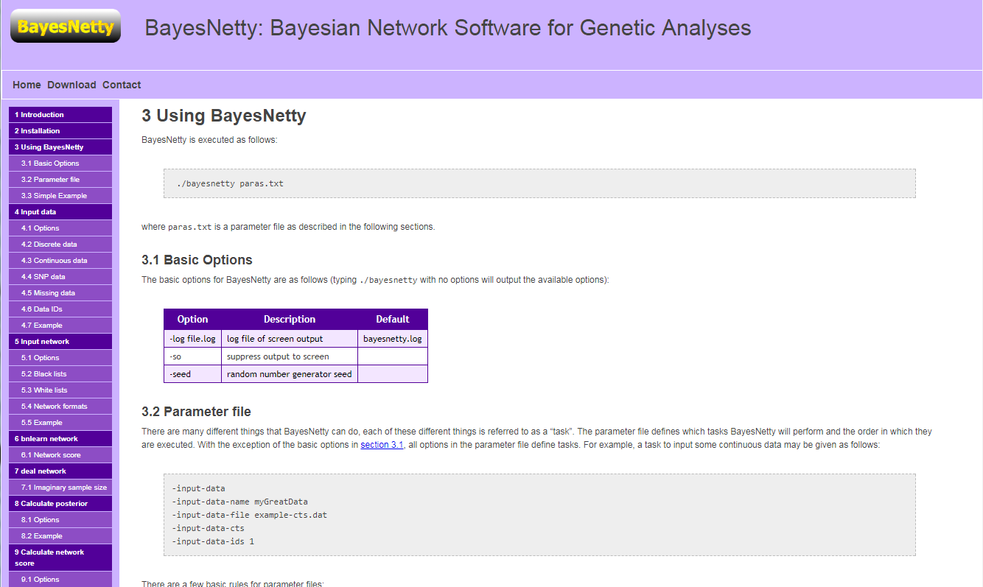
Search algorithms
Constraint-based methods such as the PC algorithm and the Fast Causal Inference (FCI) algorithm
Generally start with a fully connected graph and carry out a series of marginal and conditional independence tests to decide which edges to remove.
Score based algorithms
Can be Bayesian or frequentist
We use the (frequentist) score-based algorithm from the R package bnlearn (with the BIC score as default) as a basis of our BayesNetty method/software package

Slide 14
BayesNetty search algorithm
Idea is to move around through network space in order to determine the most plausible BN(s) (whose structure and parameter values are most compatible with the observed data)
i.e the BN(s) with the best score (highest or lowest, depending on how the score function is defined), or the highest posterior probability, out of all possible BNs.
Note that BNs that represent the same set of conditional independence relationships between the variables have the same score, and cannot be distinguished from one another
Are said to be observationally equivalent
Can be considered equally plausible
We previously showed that BayesNetty performed competitively with, or better than, other algorithms (such as MR-BMA and SMUT) (Howey et al. 2020 PLOS Genet 16(3):e1008198)

Slide 15
Missing Data Problem
Bayesian Network fitting algorithms assume that all individuals have observations at all measured variables.
Missing data can be problem for many statistical methods.
A typical approach is to reduce your data to a data set with no missing data.

Slide 16
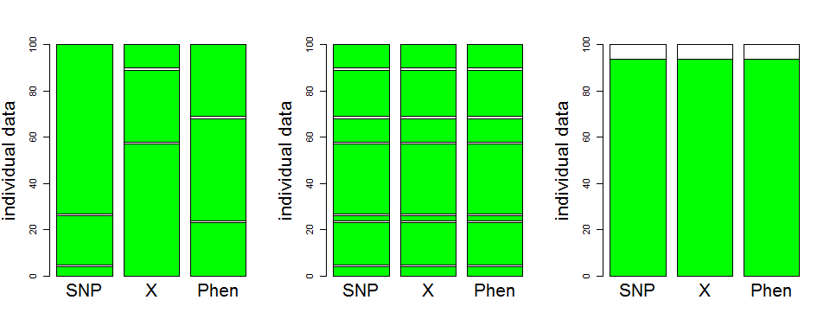
Missing Data Example 1
Original Data
Analysis Data

Slide 17
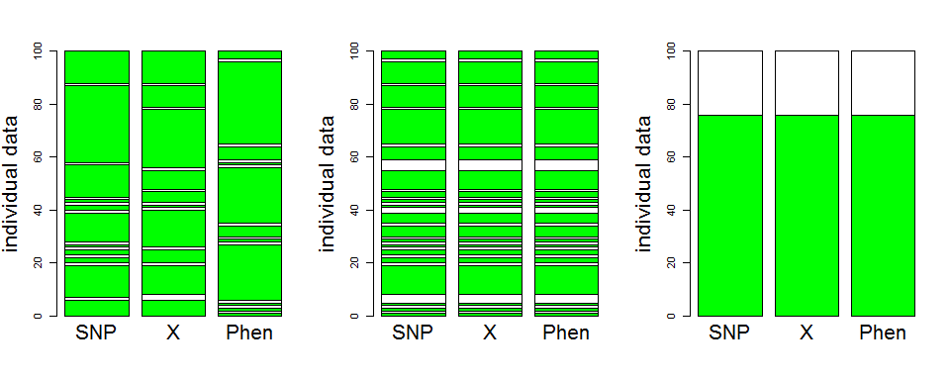
Missing Data Example 2
Original Data
Analysis Data

Slide 18
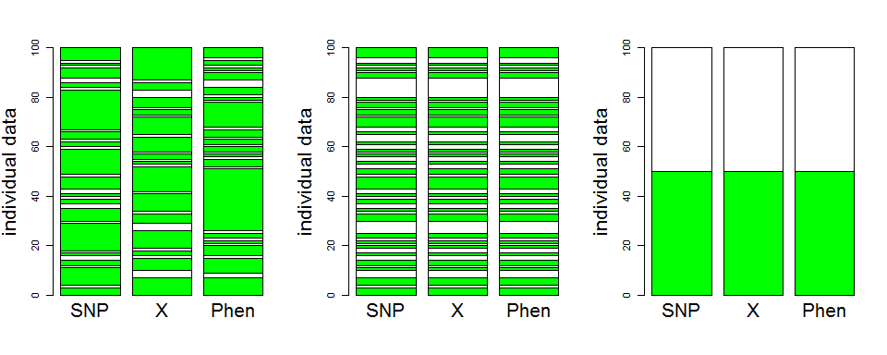
Missing Data Example 3
Original Data
Analysis Data

Slide 19
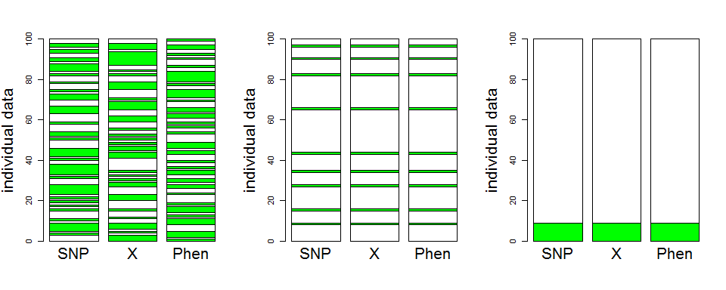
Missing Data Example 4
Original Data
Analysis Data

Slide 20
Missing Data Imputation for fitting Bayesian Networks
Can we impute missing data in order to improve the estimation of the correct network?
NOT: Can we impute the missing data as accurately as possible?

Slide 21
Nearest Neighbour Imputation
Popular method for imputing clinical data (Beretta and Santaniello, 2016)

Slide 22
Nearest Neighbour (NN) Imputation
X
Y
Ph
Individual | X | Y | Phen. | Distance to Indiv. 1
1 | 1.1 | ? | 1.4 | NA
2 | 2.3 | ? | 2.2 | NA
3 | 3.1 | ? | 3.3 | NA
4 | 1.2 | 3.3 | 1.1 | 0.3
5 | 2.1 | 7.2 | 2.4 | 1.4
6 | 10 | 33.1 | 11 | 13.0
7 | 2.2 | 6.3 | 2.1 | 1.3
8 | 2.0 | 7.8 | 2.5 | 1.4
9 | 3.3 | 10.1 | 3.4 | 3.0
3.3
6.3
10.1

Slide 23
Which variables should we use for Nearest Neighbour Imputation?
B
E
A
F
G
C
I
H

Slide 24
Nearest Neighbour Imputation Algorithm
Individual 1
B
E
A
?
D
C

Slide 25
Nearest Neighbour Imputed-CT Algorithm
Individual 1 - Estimate network using a
single 90% bootstrap subsample from people with complete training data
B
E
A
?
D
C
Impute C using nearest neighbour individual
chosen using variables A and B

Slide 26
Nearest Neighbour Imputed-CT Algorithm
Individual 2
?
?
B
E
A
D
C

Slide 27
Nearest Neighbour Imputed-CT Algorithm
Individual 2 - Estimate network using a new single 90% bootstrap subsample from people with complete data
?
?
B
E
A
D
C
Impute B using nearest neighbour chosen using variables A, C and D
Impute E using nearest neighbour chosen using variable D

Slide 28
Nearest Neighbour Imputed-CT Algorithm
Individual 3…N
…and so on…
?
B
E
A
D
C

Slide 29
Algorithm summary (Imputed-CT)
For each individual with missing data, a 90% bootstrap subsample of individuals is taken from those with complete data
A Bayesian network is fitted (with model uncertainty implicitly incorporated via the bootstrapping).
The variables for determining the Nearest Neighbour to use (for imputing each missing variable in the target individual) are chosen using this network.

Slide 30
Improved (default) imputation algorithm
For each individual with missing data, a 90% bootstrap subsample of individuals is taken from all individuals
Missing data values for each variable within this subset are replaced with randomly sampled values (with replacement) from the set of non-missing values
A Bayesian network is fitted (with model uncertainty implicitly incorporated via the bootstrapping).
The variables for determining the Nearest Neighbour to use (for imputing each missing variable in the target individual) are chosen using this network.

Slide 31
5 Variable Example 1
A
C
E
B
D
A ~ N(10, 1)
C ~ N(10, 1)
E ~ N(10, 1)
B ~ N(10 + βA + βC, 1)
D ~ N(10 + βC + βE, 1)

Slide 32
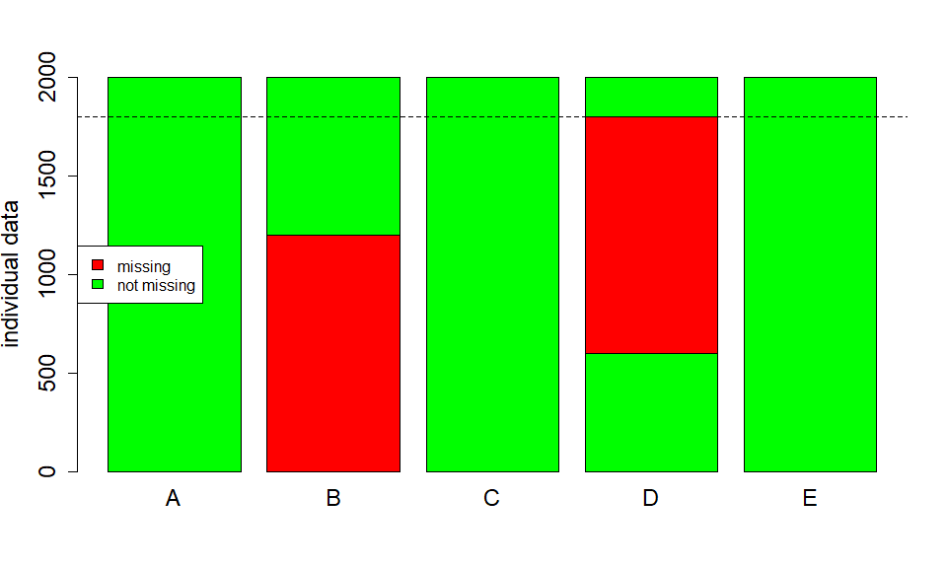
Data Structure
200
200
600
1200
1200
600

Slide 33
5 Variable Example 2
A
C
E
B
D
A ~ N(10, 1)
C ~ N(10, 1)
E ~ N(10, 1)
B ~ N(10 + βA + βC, 1)
D ~ N(10 + βC + βE, 1)

Slide 34
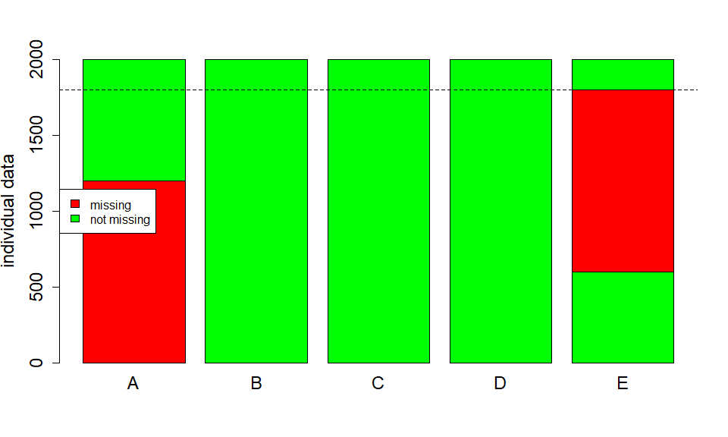
Data Structure
200
200
600
1200
1200
600

Slide 35
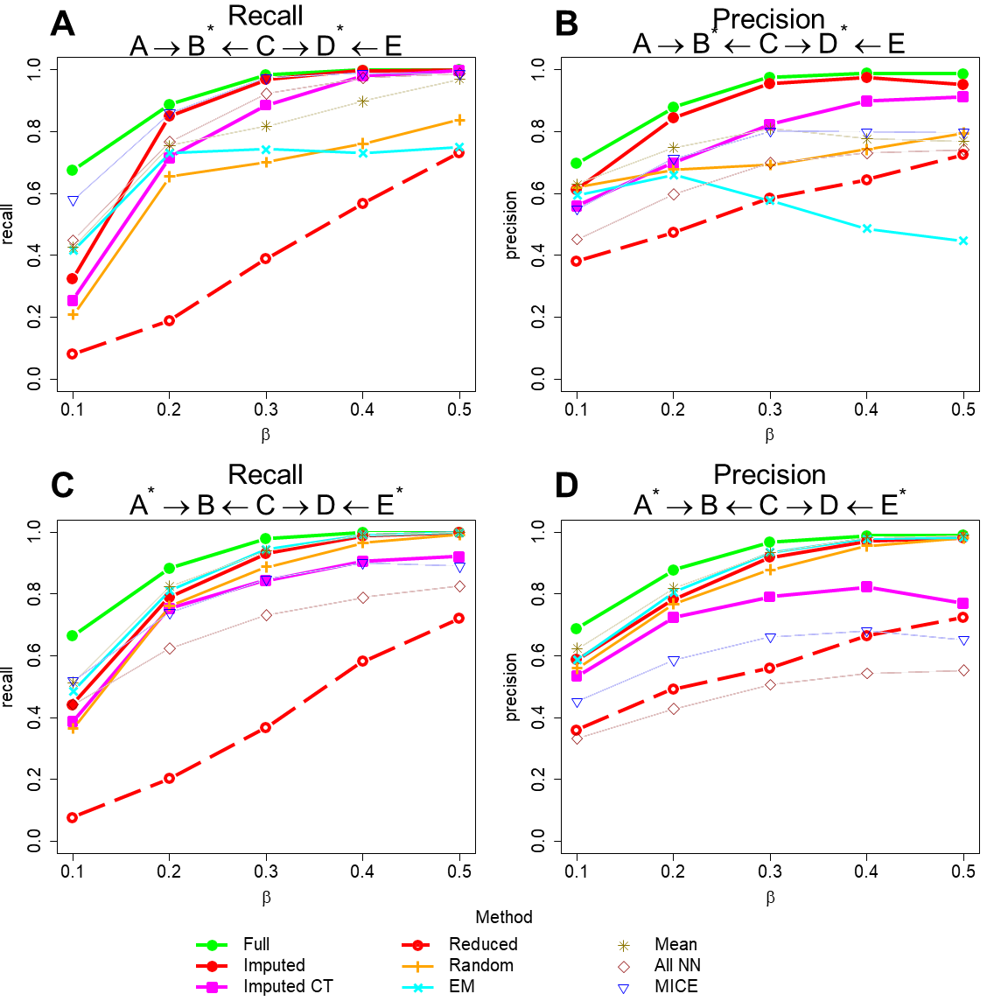
5 Variable Examples
Recall: Proportion of edges from original network that are (correctly) recovered.
Precision: Proportion of edges recovered that are indeed in the original network.

Slide 36
31 Variable Example
Light blue nodes represent genetic factors – were constrained (at analysis) to only have arrows coming out of them
Yellow nodes represent gene expression measures
All yellow nodes were set with missing data with 20% probability.
The pink node represents the trait.
Green and red arrows represent true and false findings, respectively

Slide 37
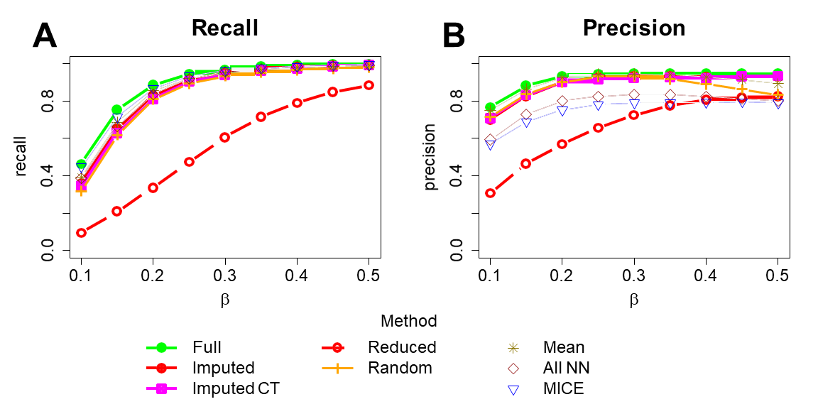
31 Variable Example
Using imputed data (even randomly imputed!) is considerably better than using the reduced data.

Slide 38
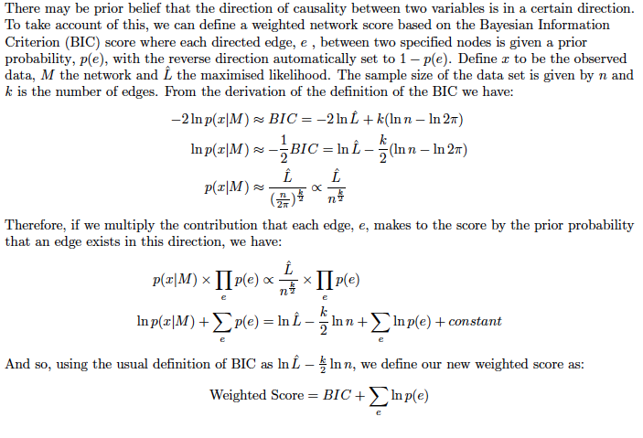
Incorporating prior knowledge
We also developed a pseudo-Bayesian approach for upweighting certain network edges
Useful if there is prior evidence concerning their direction

Slide 39
Incorporating prior knowledge
Results are shown for network edge detection as the prior probabilities of the red edges (only) are altered

Slide 40
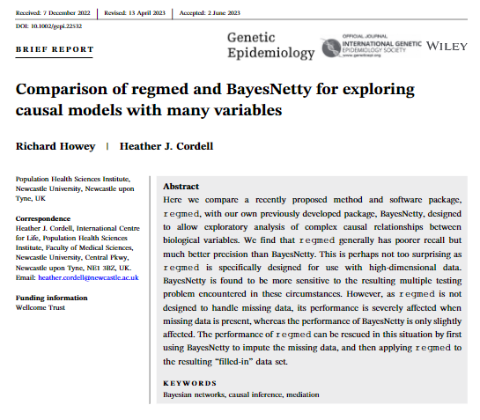
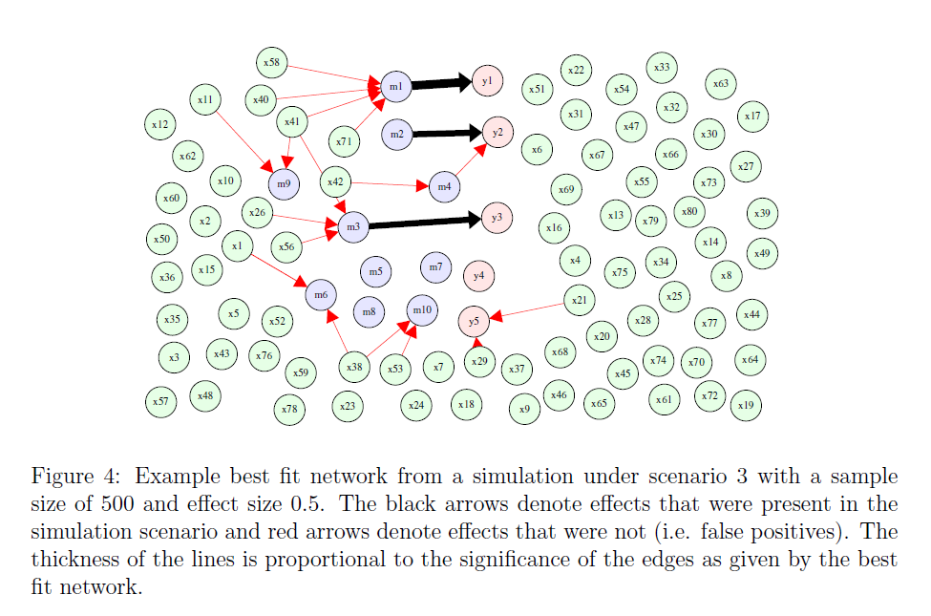
Comparison with regmed

Slide 41
Application to DIRECT data
The initial dataset consisted of over 16,000 variables including gene expression, protein, metabolite and clinical variables plus over 9 million SNP variables.
This is too many variables for Bayesian network analyses due to computational limitations and interpretation of the many resultant falsely identified edges.
The dataset was therefore reduced to a dataset with 261 variables.
Genome wide association analyses were performed to identify SNPs for the metabolites and proteins. This set of SNPs was then used to perform association analysis to identify gene expression variables of interest.
The retained SNPs were collated into 121 allele score variables.
The BMI variable also had an allele score variable created.
Allele score variables were constrained to only be parents of the corresponding metabolite, protein, gene expression or BMI variable.

Slide 42
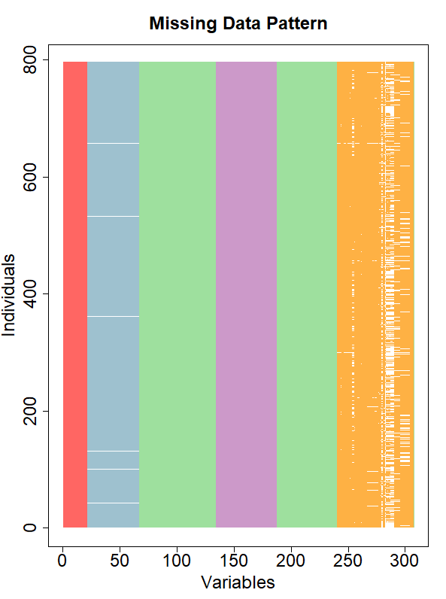
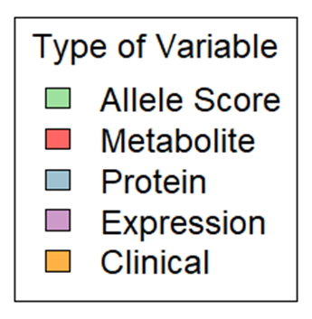
Missing data pattern

Slide 43
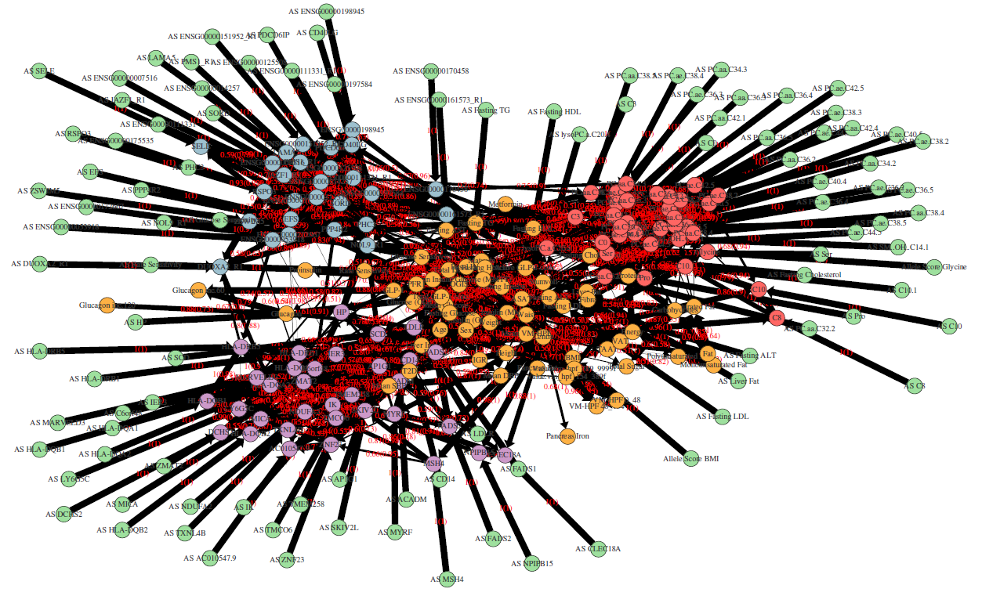
Resulting network
The network below shows a fitted average BN with all variables (strength threshold 0.5).
Edges are labelled with probabilities of existence and direction (in brackets).
The thickness of the edges is proportional to the strength of the edge.

Slide 44
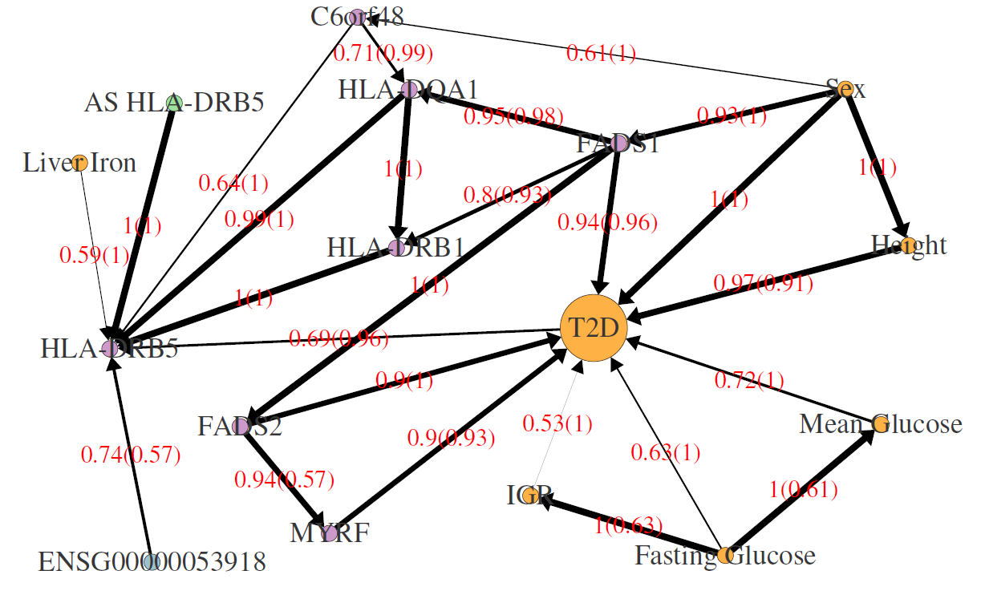
Sub-network (Markov blanket) for T2D
Markov blanket for type 2 diabetes diagnosis taken from the average Bayesian network with an edge threshold of 0.52.

Slide 45
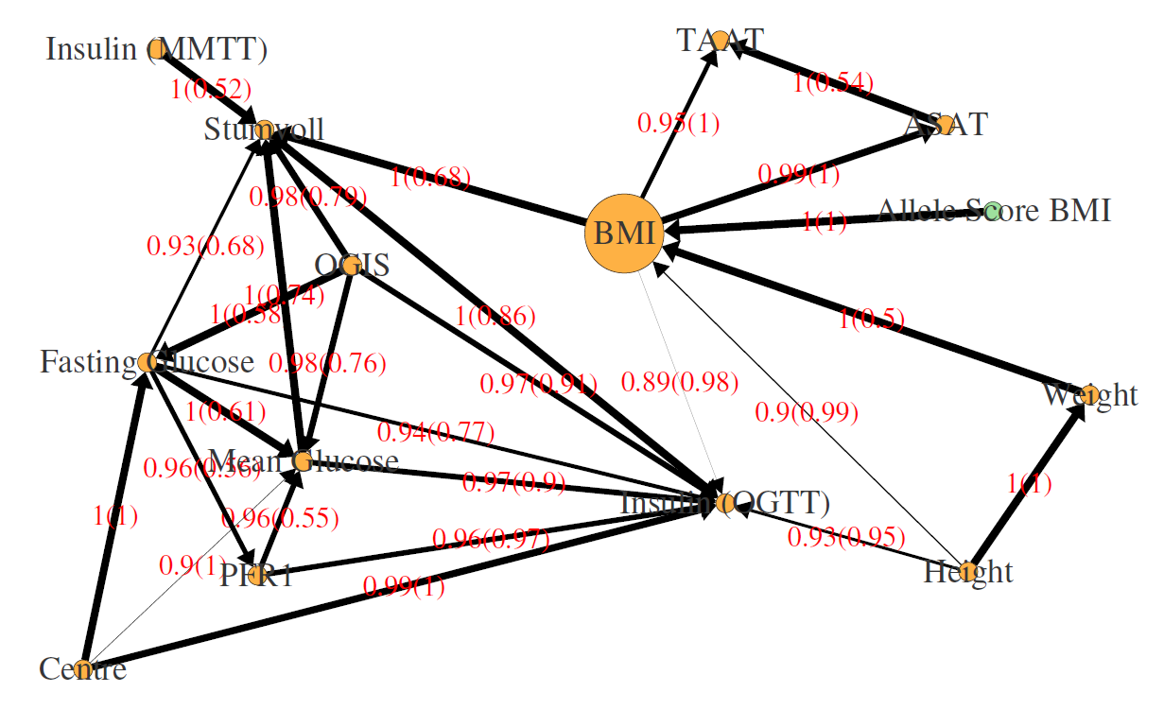
Sub-network (Markov blanket) for BMI
Markov blanket for BMI taken from the average Bayesian network with an edge threshold of 0.85.

Slide 46
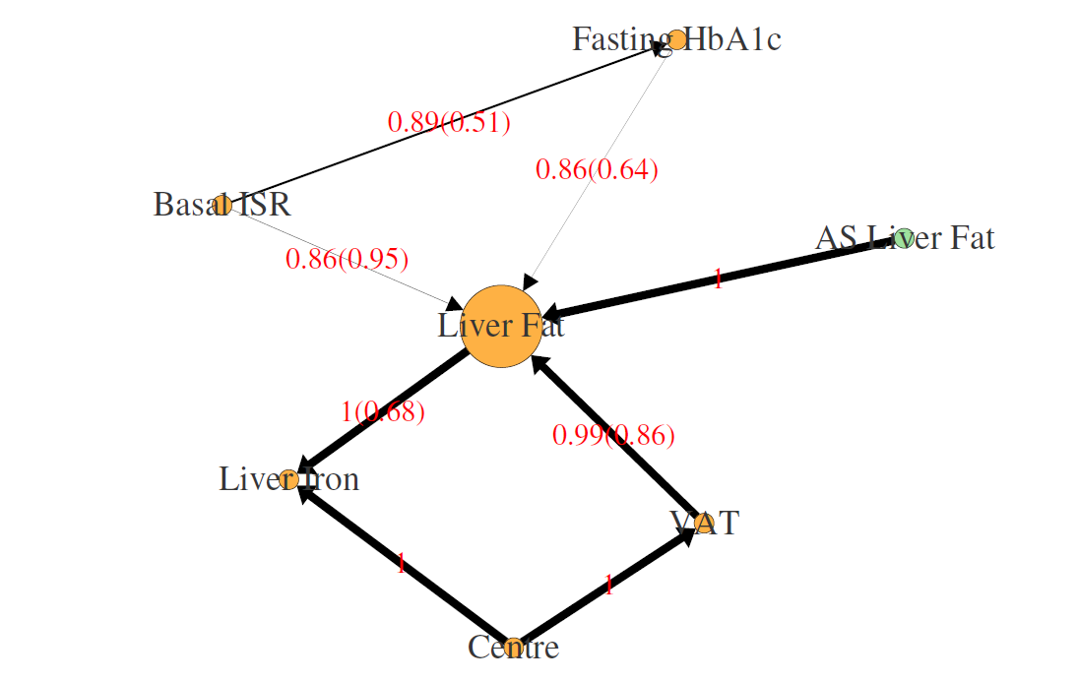
Sub-network (Markov blanket) for liver fat
Markov blanket for liver fat taken from the average Bayesian network with an edge threshold of 0.85.

Slide 47
Conclusions
Nearest Neighbour imputation can be used to impute data for Bayesian Network analyses, while preserving the data structure.
Network uncertainty can be accounted for by taking a new single 90% subsample of data to inform the imputation for every individual with missing data
(either from those with complete data, or else randomly imputed)
and by then fitting a network to this subsample, informing the choice of variables to be used for the NN assignment
Once the missing data has been imputed, a best-fit (or average) BN can be estimated in the usual way
For this purpose, our method performs competitively with, or better than, alternative imputation approaches

Slide 48
BayesNetty Software
Howey et al. (2020) PLoS Genet 16(3):e1008198
Howey et al. (2021) PLoS Genet 17(9):e1009811

Slide 49

Acknowledgments
Wellcome Trust (grant references 102858/Z/13/Z and 219424/Z/19/Z)
Ana Viñuela for providing us with access to the DIRECT data set

