Slide 1
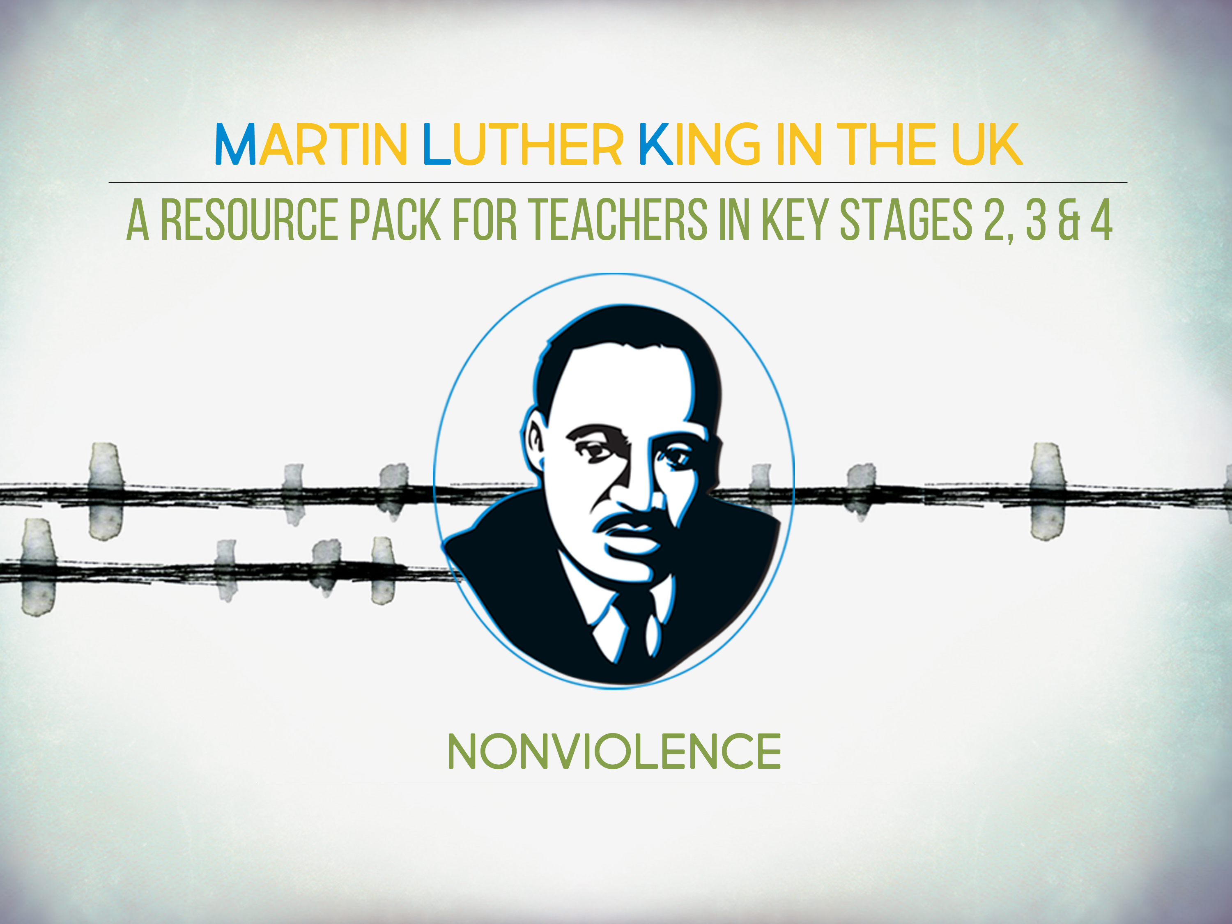

Slide 2

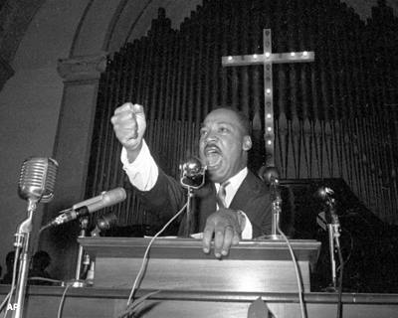
‘You have heard that it was said, “Love your neighbour and hate your enemy.”
But I tell you, love your enemies and pray for those who persecute you, that you may be children of your Father in heaven. He causes his sun to rise on the evil and the good, and sends rain on the righteous and the unrighteous.’
- Jesus, The Gospel according to Matthew, chapter 5, verses 43-45
Notes:
Do you think this is good advice? [Advance animation] After class discussion, bring up image of King preaching. Rev Martin Luther King Jr. was a Christian preacher in the Baptist church, and the son, grandson, and great-grandson of preachers. This was one of his favourite Bible verses.

Slide 3
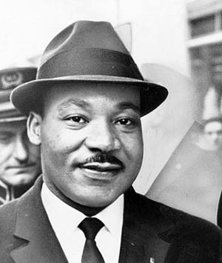
“Nonviolence is a powerful and just weapon, which cuts without wounding and ennobles the man who wields it. It is a sword that heals.”
- Martin Luther King, Jr.

Slide 4
A NONVIOLENT ACTIVIST…
WILL…
Break an unjust law rather than obey it
Love an oppressor
Train him/herself to react calmly - not with anger
Plan carefully with others
WILL NOT…
Shout at, swear at or insult an oppressor
Hate an oppressor
Retaliate with violent actions or words
Resist or avoid arrest or punishment for breaking a law
Notes:
Could this be an exercise sheet that students draw lines to two different boxes?

Slide 5
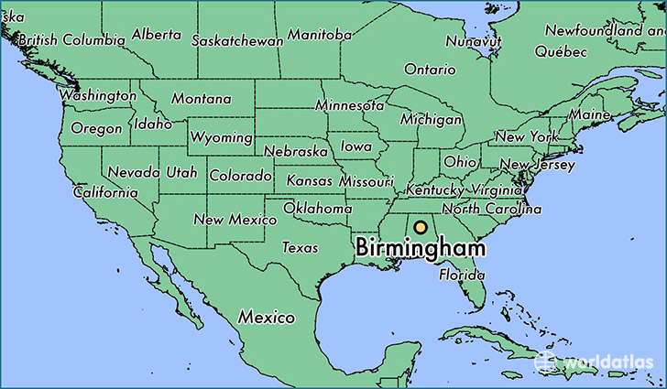
Notes:
Does nonviolence work in the real world? In these two lessons we shall look at Martin Luther King’s campaign against segregation in Birmingham, Alabama, April-May 1963.

Slide 6
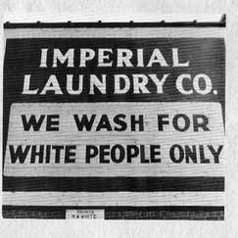
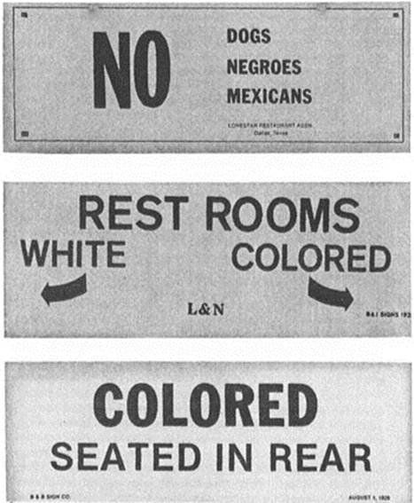
Notes:
1963 Rev Martin Luther King and his local ally Rev James Bevel decided to challenge desegregation in Birmingham. It was a tough place, with strong segregation in public places, and discrimination in the workplace. Blacks and whites were each meant to have separate but equal facilities, but in practice the whites had the best schools, restaurants, libraries, sports facilities, etc in the city. Most black people could not vote.
There had been so many attacks on blacks and bombings of their homes and churches that it saw nicknamed ‘Bomingham’
.

Slide 7
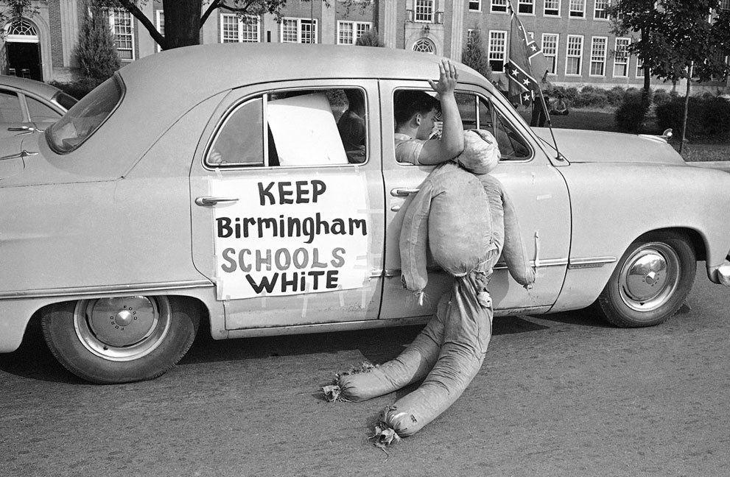
Notes:
There was popular support amongst many white people for segregation

Slide 8
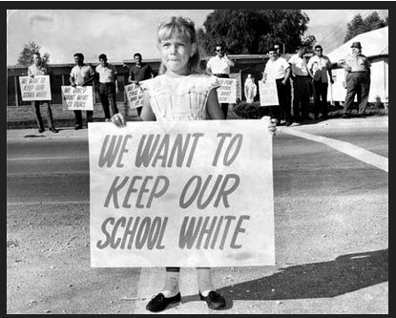
Notes:
White children were brought up to be supporters of segregation.

Slide 9
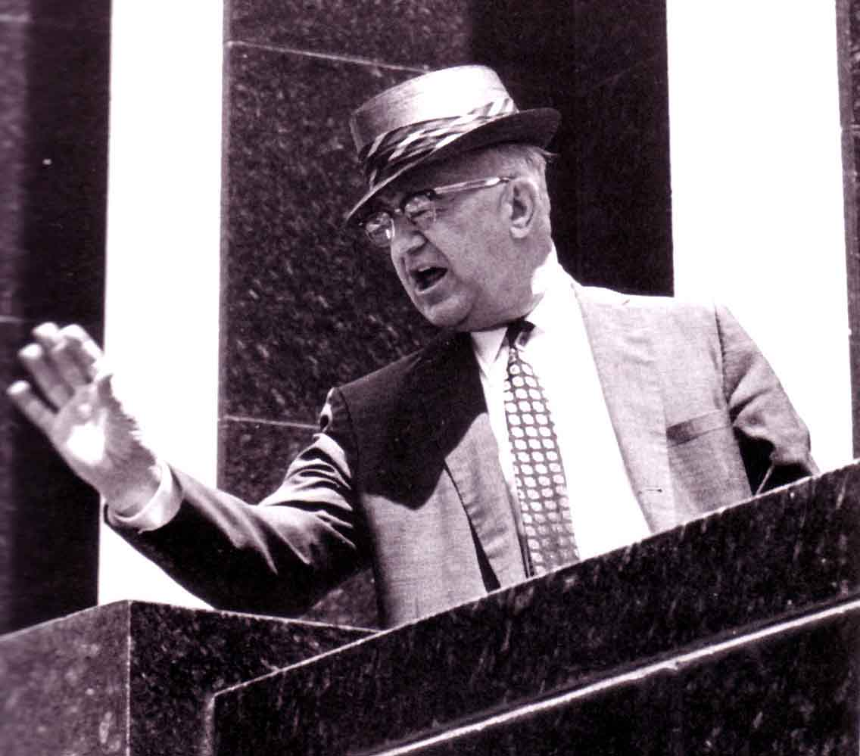
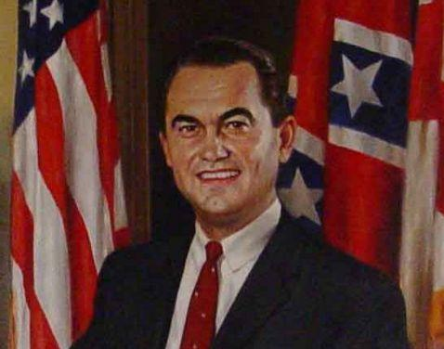
Notes:
Birmingham Police chief ‘Bull’ Connor (left) was known as very strict and pro-segregation. State Governor George Wallace (right) said in a rally, ‘Segregation now, segregation tomorrow, and segregation forever.’

Slide 10
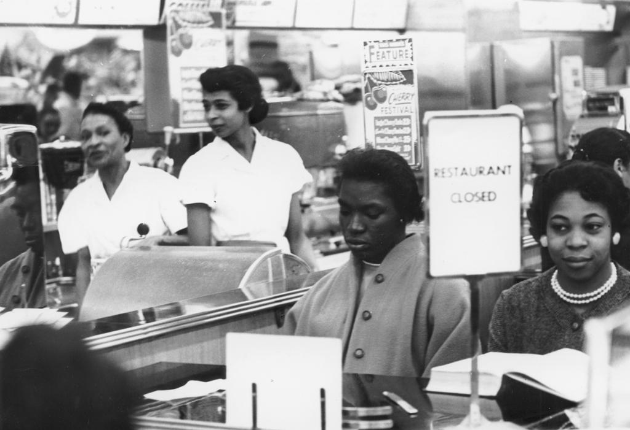
Notes:
The church leaders drew up a plan, which they called– ‘Project C’ for confrontation. The use nonviolent tactics to end segregation in schools, lunch counters, toilets, parks etc. This was launched on April 3, called ‘B [Birmingham] day. Here we see black women sitting at a white’s only lunch bar, which managers closed rather than serve blacks. Also they boycotted shops which refused to employ black workers or serve black people.

Slide 11
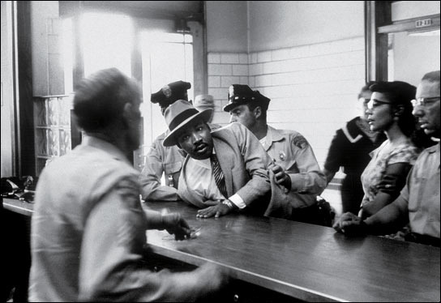
Notes:
Failed to get results, people arrested. So planned larger marches and protests to close down city centre for business. Hundreds arrested, Bull Connor, April 10, got court order to ban these protests.
Protestors ignored this, April 12 march on city hall, King and other leaders arrested – King in jail for nine days. This was the 13th time he had been arrested. During this time he wrote a famous ‘letter form Birmingham jail.’

Slide 12
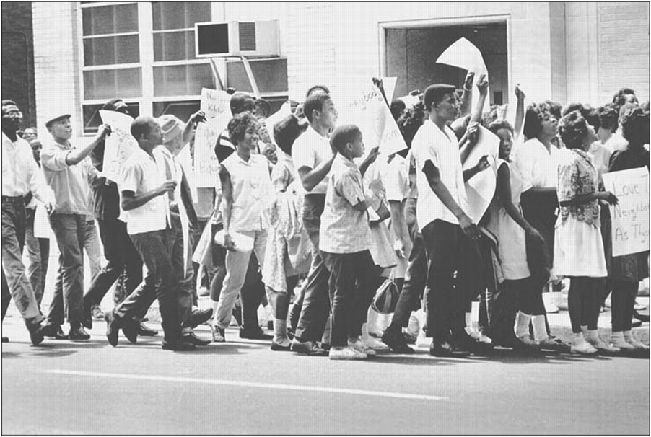
Notes:
Early May, Rev James Bevel led plan to lead schoolchildren to defy ban on nonviolent action. May 2 ‘D-Day’ - large numbers of children, trained in how to deal non-violently with police action, assembled in churches, and marched into city. 1000 arrested.

Slide 13
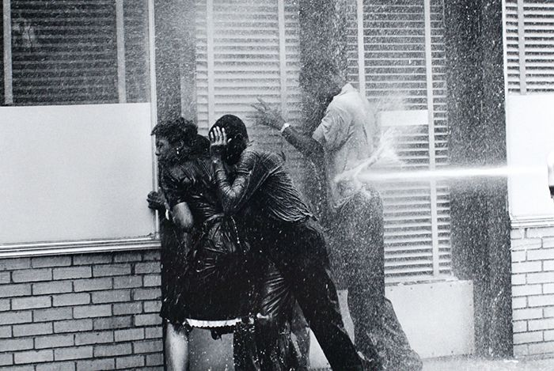
Notes:
Next day, ‘Double-D Day’, more children bunked off school to join marches. Jails were full so Bull Connor decided to end the marches with violence. ‘Let ‘em have it!’ he yelled as police dogs and fire hoses powerful enough to strip bark from trees were turned on children, who were also beaten.

Slide 14
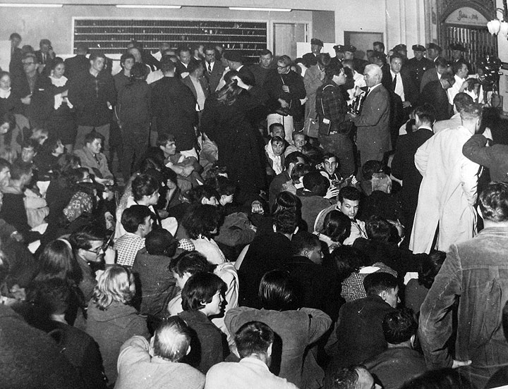
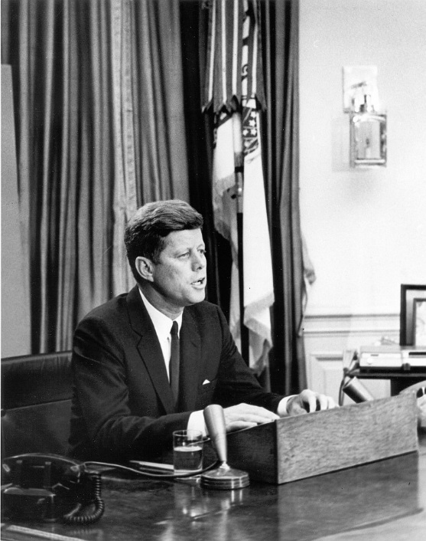
Notes:
Thousands more protestors came from all around the country to enter white-owned businesses and staged ‘sit-ins’, not moving and blocking trade. They boycotted white businesses m- and business in general closed down. The police could not arrest more people and, on May 8, white businesses agreed to end segregation and hire blacks to work for them. But the political leaders of the city still wanted to keep segregation.
As images of violence against children had gone around the world shaming the nation, President Kennedy intervened and promised a Civil Rights Act to prohibit segregation and racial discrimination in employment: it was passed in 1964.

Slide 15
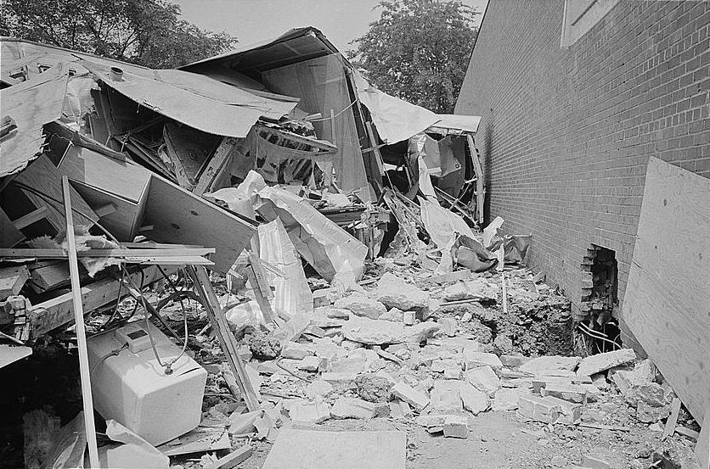
Notes:
Many people remained unhappy: on the night of May 11 a bomb exploded at the Gaston Motel where King had been staying. This led to riots, which King returned to calm down and call for nonviolence.

Slide 16
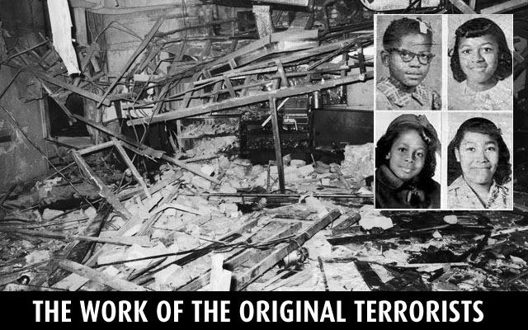
Notes:
After King led the successful campaign to desegregate public places in Birmingham in 1963, racists took revenge by bombing 16th Street Baptist Church, which had been the central point of the Birmingham campaign. Four little Sunday-school girls were killed.

Slide 17
The Children’s Crusade,
Birmingham, 1963.
Imagine that, when you were as old as you are now, you were an African American child from Birmingham who took part in the Children’s Crusade. Fifty years later, as an old person, you have been asked to write about your memories for a magazine.
HINTS: You might want to include the following points: how you felt at different times in the day – conversations with family and friends – your reflections on the campaign – whether you think of yourself as a hero?

Slide 18
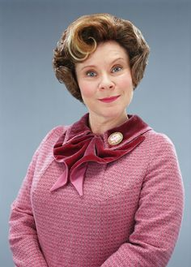
ACT 1: ‘THE PLAN’ – separate but equal.
A new head-teacher is appointed with a new ‘plan.’ ‘The Plan’ is that children of poor parents must wear bright red badges at school. The rich children can go into lunch first, and get free snacks at break in classrooms, which the badged kids don’t. The red-badged children must sit at the back of the class and are not allowed to use computers in IT lessons because there are not enough. She explains that ‘the plan’ is to help the poorer kids by giving them special attention, because poor and rich kids learn differently. Many parents and teachers are unhappy.
At a meeting of the class reps for the school council, run by a sympathetic teacher who dislikes ‘the plan’, you have a chance to plot a campaign of nonviolent action to challenge it.

Slide 19
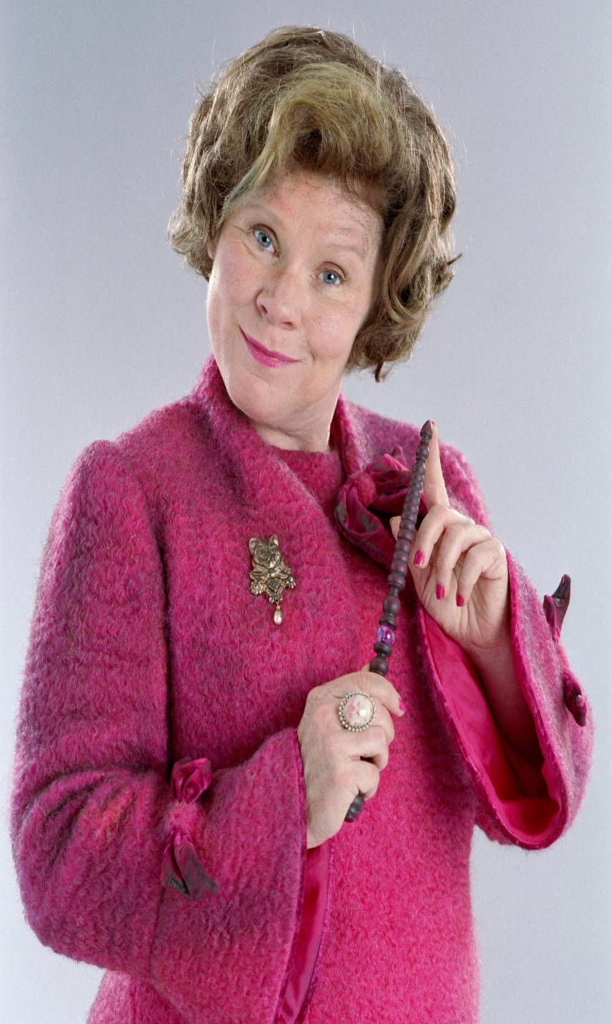
ACT 2: CRACKDOWN!
Teachers who criticised the plan are sacked and replaced with people loyal to the head-teacher. Parents are told that the children are lying, and any parent who wants to can remove their children. Because there are few schools in the area and it gets great exam results, most don’t.
The head-teacher is annoyed at resistance. So she puts the badged and non-badged kids in separate classes, with different break and lunch-times, so there is no mixing – this is to prevent protests and also planning. School council is suspended. Also, she offers extra rewards – house-points and book prizes – to badged children who tell on who is organising protests. Some of the non-badged kids start enjoying having privileges, and so begin supporting the head-teacher.
What do you do now?

Slide 20
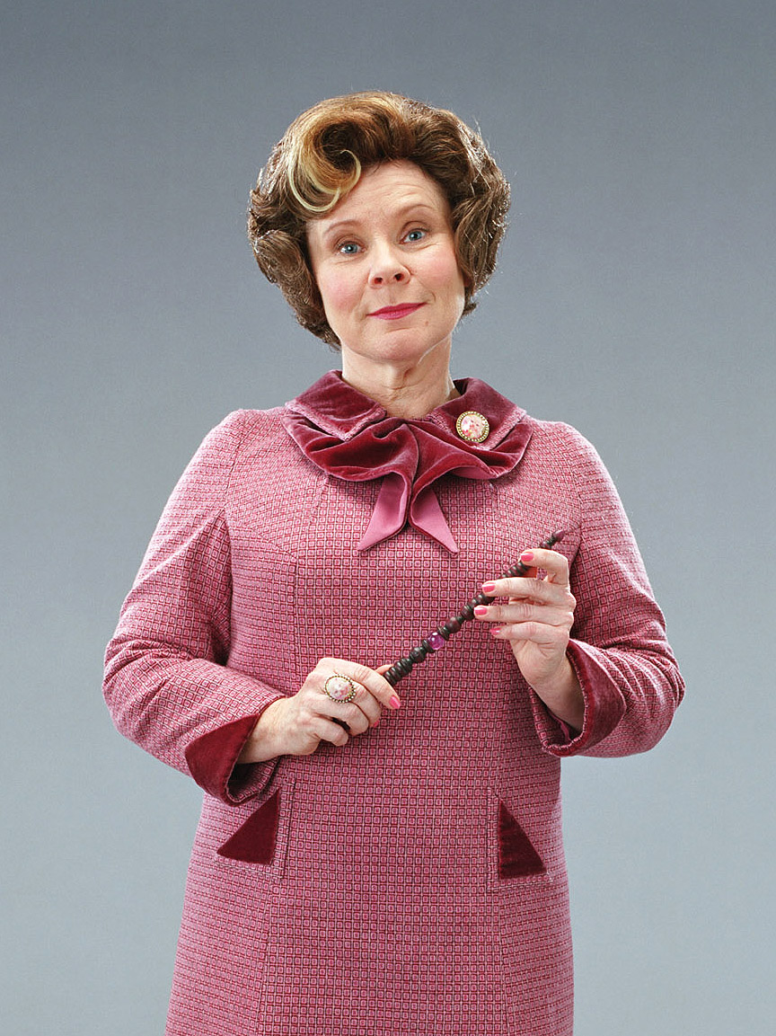
ACT 3: SHOWDOWN!
The head-teacher is furious at continued resistance. She puts up CCTV cameras around the school which she watches from her office, and hires security guards armed with canes to patrol and punish resistance. She also announces that, as a punishment, only the non-badged children will be allowed to take part in the Christmas Play. The Christmas Play is the major event in the school year, and the head-teacher wants to make it the best one in the school’s history to divert attention away from ‘the plan’ and the protests. To do this, she has got a local supermarket to sponsor the event, and has invited VIPs including the mayor, the MP, school governors, and local newspaper and television journalists. Everything is gearing up for the big day.
How can you use the Christmas play to try and win your campaign?

Slide 21
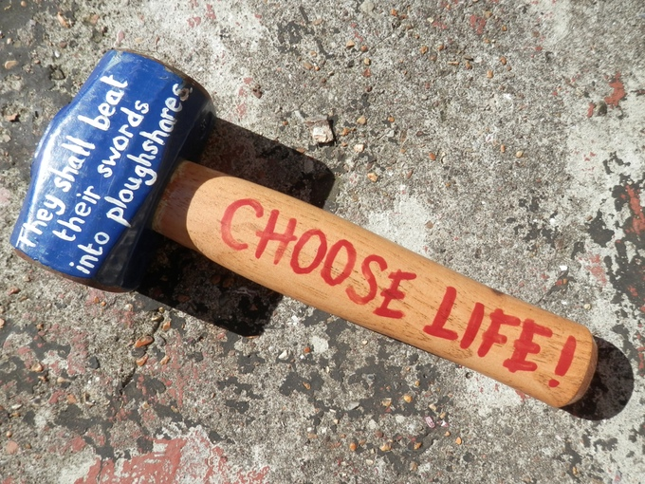
Nonviolence lesson 4:
‘Ploughshares’ women versus British Aerospace

Slide 22
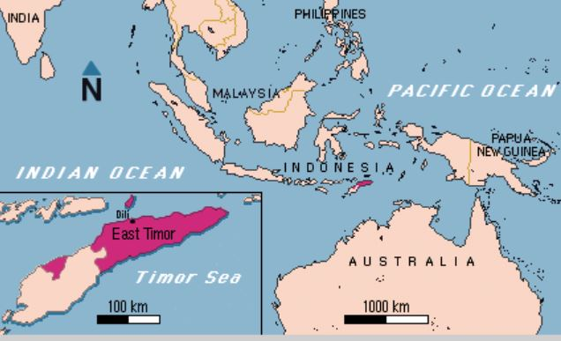
Notes:
In 1975 Indonesia invaded the country of East Timor, which had just become free of Portuguese rule, wanting to take the territory and resources of their little neighbour. This was against international law. It is estimated that 100,000 people died during the military occupation.

Slide 23

Notes:
The British government had been allowing British Aerospace, a UK company, to sell Hawk jet planes to Indonesia. These could be used for training or ground attack. In 1991 the Indonesian military killed 300 young people in a nonviolent demonstration: soon afterwards, it began negotiating with Britain to buy 24 more jets.

Slide 24
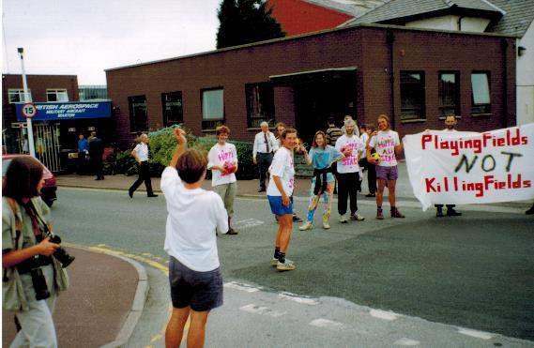
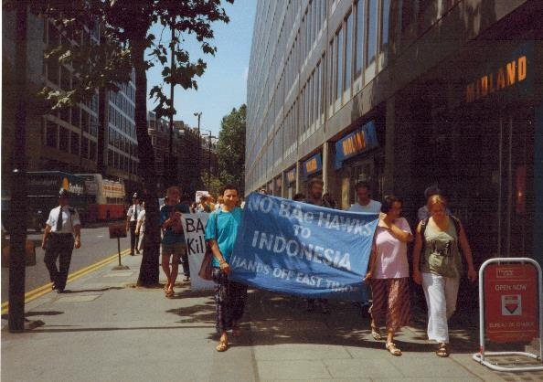
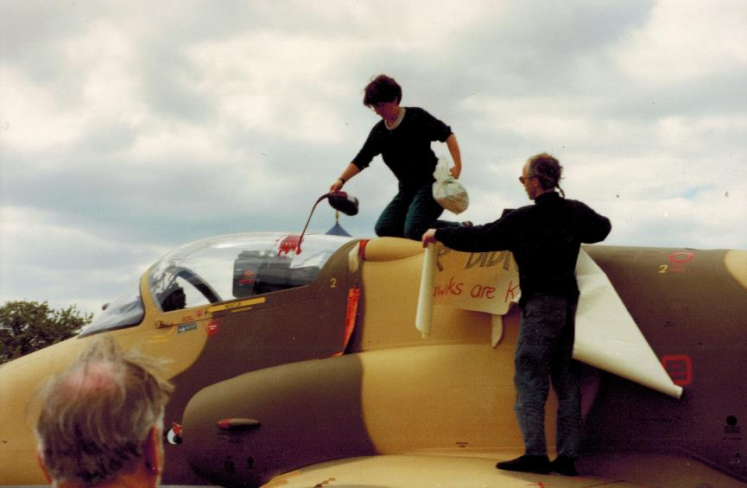
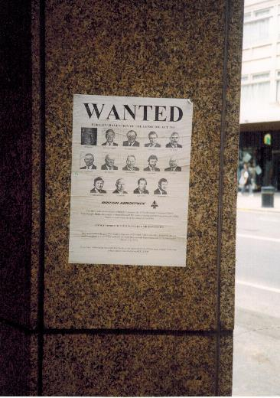
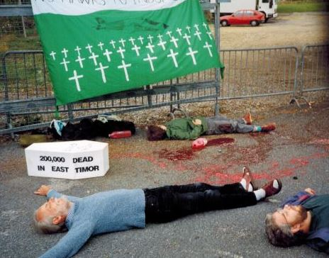
Notes:
British peace activists protested for years. They wrote letters to the Prime Minister, and did nonviolent protests like those above. In the bottom left we see them pouring fake blood on a Hawk jet at an airshow.

Slide 25
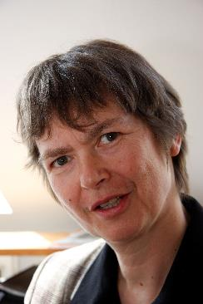
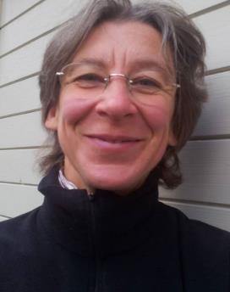
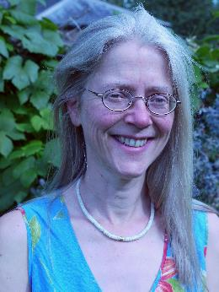
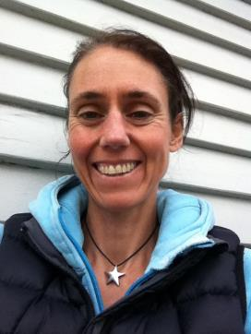
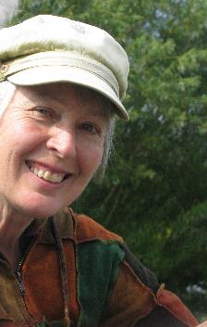
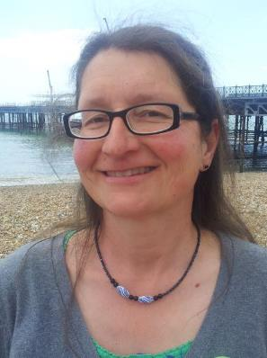
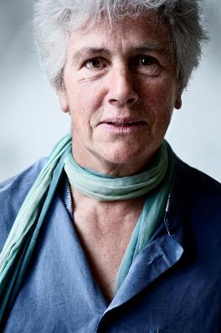
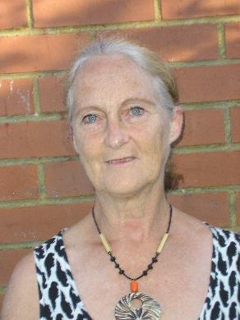
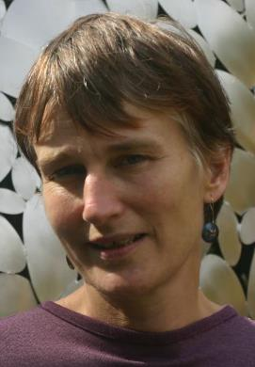
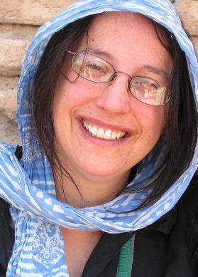
The Seeds of Hope East Timor Ploughshares group
Lotta
Jo
Ricarda
Jen
Rowan
Lyn
Andrea
Angie
Clare
Emily
Notes:
This group of women had tried everything, and it had failed: the jets were going to be sold. So they decided to try and disarm them before they could be sent to Indonesia.

Slide 26
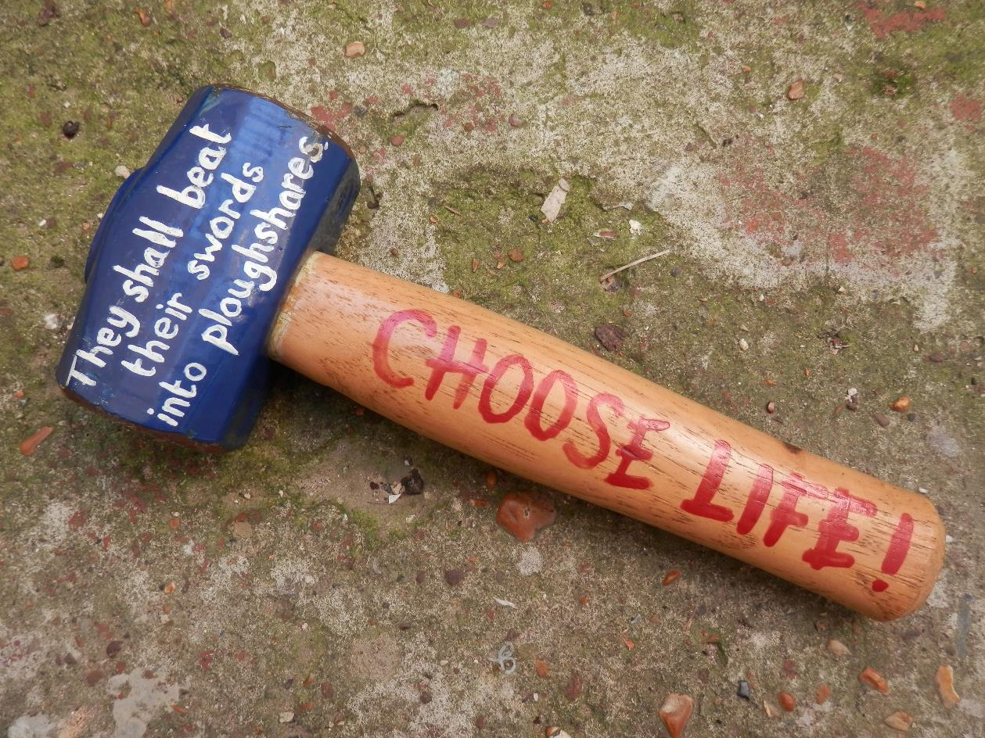
“He will judge between the nations and will settle disputes for many peoples. They will beat their swords into ploughshares and their spears into pruning hooks. Nation will not take up sword against nation, nor will they train for war anymore.” - The Bible, Isaiah 2:4
Notes:
Why did they call themselves ‘ploughshares’? It was from a verse in the Bible. They wrote this verse on the hammers they used.

Slide 27
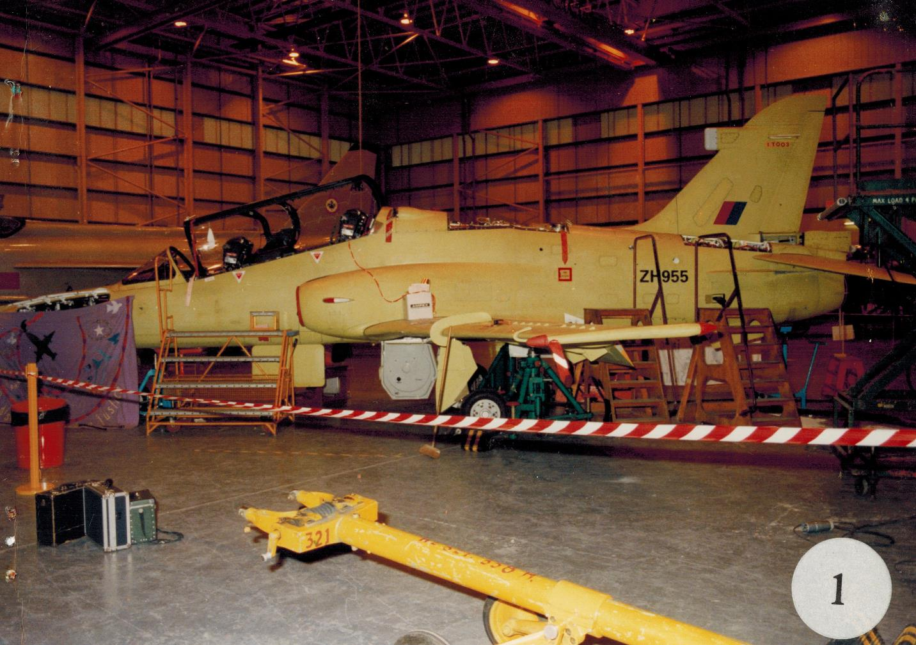
Notes:
On January 29 1996 they broke into the British Aerospace factory at night, and found a Hawk destined for Indonesia.

Slide 28
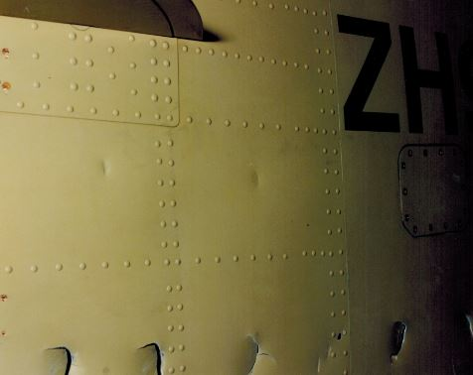
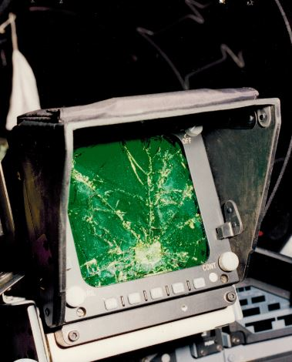
Notes:
They smashed it all over with hammers, causing £1.7m damage. These are examples of damage done.

Slide 29
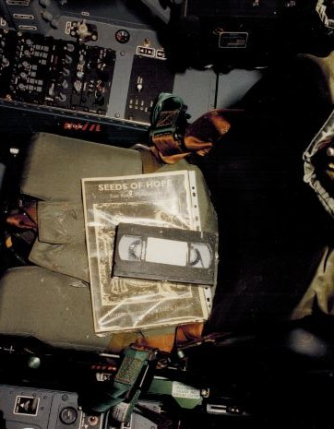
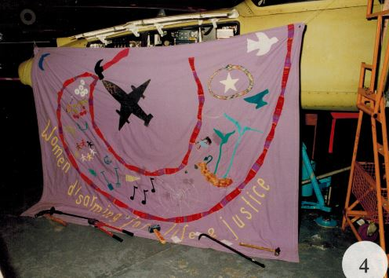
Notes:
They left messages in banners and on a video tape, explaining what they had done. They didn’t try and run away, but waited to be arrested, sitting crossed-legged with hands out so security guards could see they were not threatening and would not be afraid.

Slide 30
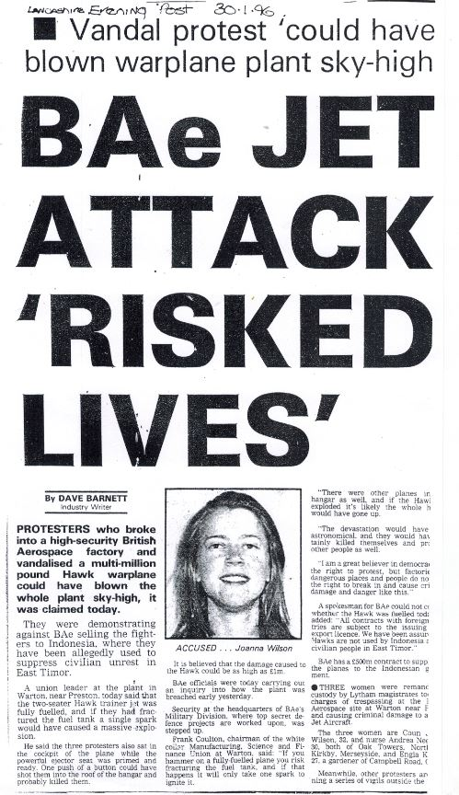
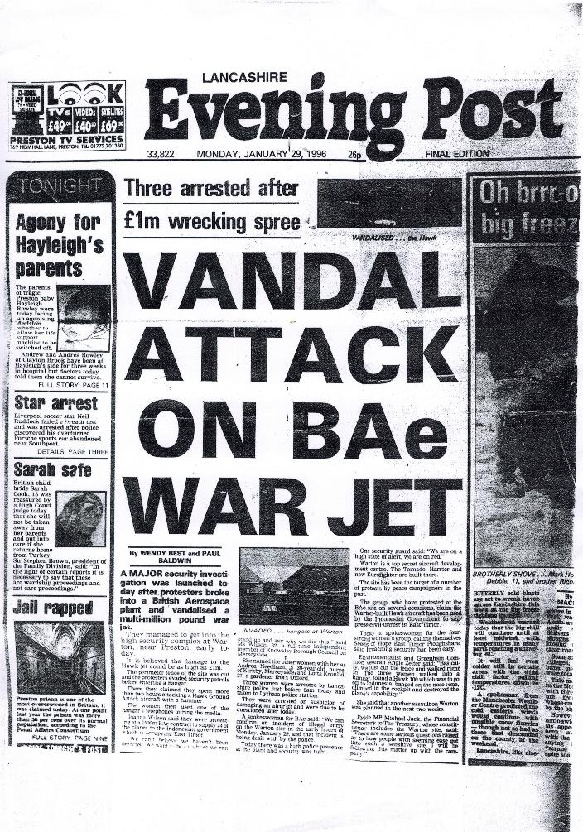
Notes:
The newspapers were hostile, describing them as vandals.

Slide 31
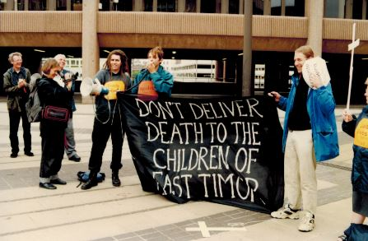
Notes:
They were put in prison before trial at the court in Liverpool. Their supporters demonstrated outside the court during the trial.

Slide 32
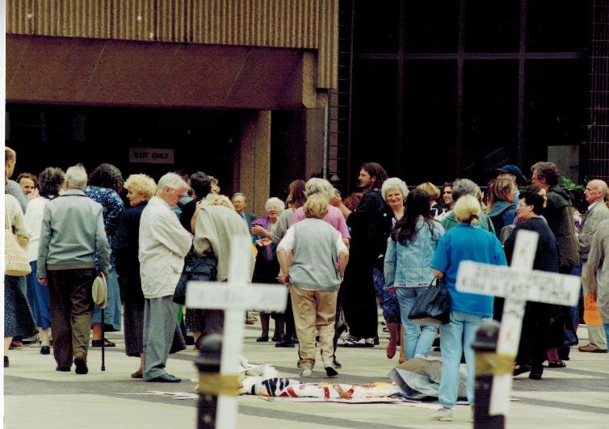
Notes:
Local churches in particular supported the women, with processions and prayers every day.

Slide 33
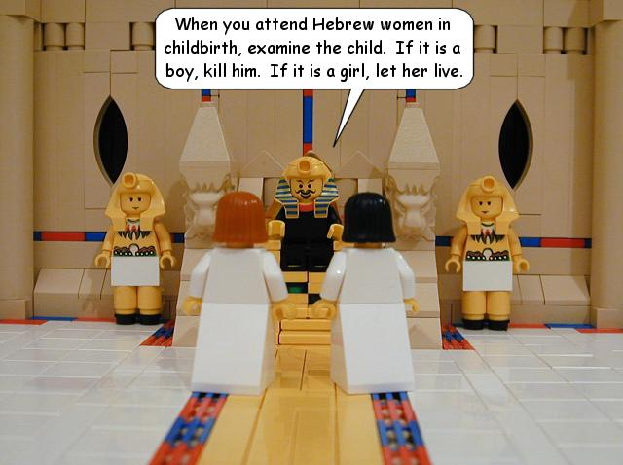
Nonviolence Lesson 5:
Women and nonviolence - Hebrew midwives vs Pharaoh

Slide 34
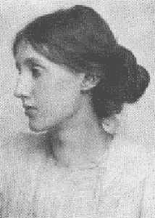
“For though many instincts are held more or less in common by both sexes, to ﬁght has always been the man’s habit, not the woman’s.”
Women “can best help [men] to prevent war not by repeating [their] words and following [their] methods but by finding new words and creating new methods.”
Virginia Wolf, Writer, Three Guineas, 1938
Notes:
Martin Luther King was criticised for not giving women greater prominence in his campaigns. Writer Virginia Wolf said that wars are caused by men not women, and women can best help prevent wars by rejecting men’s methods and finding their own. Do you agree?
Draw attention to the date of publication – on the eve of World war 2.
(slide. Do you agree? Can you think of any examples? [Teacher can refresh the ‘ploughshares 4’ women lesson].

Slide 35
African Americans moving to Chicago had found “not a land of plenty but a lot replete with poverty… not a Promised Land but rather another Egypt-land of denial, discrimination and dismay”
- Martin Luther King, Chicago, 1965.

Slide 36
Nonviolence lesson 6: Malcolm X and Martin Luther King

Slide 37


Do you recognise these two civil rights leaders? If so, what do you know about them?

Slide 38

Martin Luther King, Jr.
Born January 15, 1929 in Georgia, USA.
Baptist minister & political activist.
The most famous civil rights leader in America.
Committed to nonviolence (peaceful protest).
Assassinated April 4, 1968, in Memphis, USA.

Slide 39

Malcolm X
Born May 19, 1925, Nebraska, USA.
Muslim minister and human rights advocate.
Argued that African Americans should seize their rights ‘by any means necessary.’
Assassinated February 21, 1965, New York City, USA.

Slide 40

What was Malcolm X’s contribution to the civil rights movement?
Malcolm helped inspire a generation of activists increasingly frustrated with the slow progress of the civil rights movement.
He was essential to the developing black power movement of younger, more radical activists who became more prominent in the late 1960s and 1970s.

Slide 41
Ossie Davis, a black actor and activist had this to say about Malcolm…
‘Martin Luther King and the regular civil rights leaders were presenting to America our best face, our nonviolent face… We just wanted to be included. But they also understood that America, in spite of our reassurances, would be frightened and hesitant to open the doors to Black folks.’

Slide 42
Ossie Davis
‘Malcolm was the outsider, the man they thought represented the possibilities of violence. They would say to the powers that be, "Look here's Martin Luther King and all these guys. We are nonviolent. Now outside the door if you don't deal with us is the other brother (Malcolm), and he ain't like us... White America, in order to escape Malcolm, to deal with us." That was the strategy. ’

Slide 43

The March on Washington, August 27th, 1963
Martin Luther King delivered his famous ‘I have a dream speech.’
Though Malcolm criticised the March, he was in Washington, telling a reporter, ‘Whatever Black folks do, I'm going to be there, Brother, 'cause that's where I belong.’

Slide 44

When he returned from Mecca, he committed himself to issues of human rights all over the world.
He recognised that he was the ‘alternative’ to King, and that this made white people move towards King’s ideas.

Slide 45

Martin meets Malcolm, 1964
When the two men met in 1964, they were much closer in their ideas than they ever had been before.
Malcolm was prepared to do what he could to help King’s movement, and King was becoming increasingly radical – criticising the government about the war in Vietnam.

