Slide 1
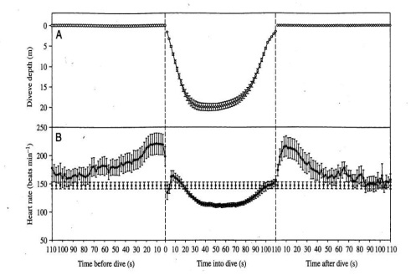
Deep Diving Birds: Over-coming the pressures of the Deep!
Introduction - Many birds are dependent on seas, rivers and lakes for their food source; however few actually travel great depths in order to obtain this. The term ‘diving bird’ is given to birds that voluntarily submerge itself under natural or quasi-natural conditions (Kooyman et al., 1992). There is a very small proportion of diving birds in the world, where there are only ten known families of diving birds out of a total of 168 families (Stonehouse., 1975). An extended dive duration allows diving birds to access food at greater depths which is unattainable to other competitors while also avoiding predation (Holm & Burger., 2002). Dive duration is limited by a birds oxygen storage capacity and the metabolic rate during submersion. Figure 1 demonstrates that when oxygen stores reach a certain threshold there is a gradual switch of energy production from aerobic respiration to anaerobic respiration. The point at which oxygen stores are depleted is named the Aerobic Dive Limit (ADL), diving beyond the limits of ADL increases the recovery period necessary to oxidise the lactate by-product of anaerobic respiration (Kooyman et al., 1992).
Figure 1. ADL calculated as a gradual switch; the transition of energy production from aerobic to anaerobic metabolism with depleting O2 stores over the duration of a dive (source: Bevan., 2010).
Penguins Adaptations to Conquer the Deep!
Lowering MR - Adjustments in heart rate allow the dive duration to be extended by ensuring full loading of oxygen stores before the dive, then by reducing aerobic metabolism during the dive and ensuring the full and effective use of oxygen stores while submerged (Green et al., 2003). For example, a penguin's BMR (Basal Metabolic Rate) is 60-70bpm (beats min⁻¹), increasing to 180-200bpm before the dives, then an immediate fall and then gradual reduction to 20bpm during the dive, before returning to the surface when it reaches 200bpm when the oxygen debt is replenished (Stonehouse., 1975). This trend in metabolic rate (MR) is demonstrated in Figure 2.
Regulating temperature - The feathers account for 80% of insulation by trapping air. As the penguin descends increased pressure compresses the trapped air reducing the insulative layer (Stonehouse., 1975). The results of Handrich (et al., 1997) show that during deep dives, temperatures in certain body regions of freely foraging penguins can decrease much more dramatically than in the stomach, which is cooled predominantly by the ingestion of cold prey. These temperature decreases, leading to a depressed metabolism, may be prolonged by this temperature-induced metabolic suppression that is independent of stomach-cooling (Handrich et al., 1997), giving penguins an overall energetic benefit during foraging trips.
Regulations of Asphyxia - There are major changes in blood flow during a dive, most importantly being a slowed heart rate and the reduced circulation to muscles (Stonehouse., 1975). These adjustments allow the dive duration to be extended by ensuring full loading of oxygen stores before the dive, then by reducing aerobic metabolism during the dive and ensuring the full and effective use of oxygen stores while submerged (Green et al., 2003). Reduced sensitivity to CO₂ by a greater buffering ability of the blood (Muller-Schwarze., 1984) is beneficial in extending the breath hold since CO₂ is one of the principle stimuli to terminating an apnoeic episode (Stonehouse., 1975).
Figure 2. The mapping of heart rate (beats min⁻¹) and dive depth period of before, during and after the dive from 13 breeding female macaroni penguins. Values are means +/- S.E.M. (source: Green et al., 2003).
Coping with Pressure – Penguins have probably adapted to deep dives by a reduction in respiratory O₂ stores, a relative increase in muscle O₂ stores, and a reduction in respiratory N₂ uptake, possibly secondary to either reduced cardiac output or a pressure-induced restriction of pulmonary gas exchange. Croll (et al., 1992) suggests that diving birds may have evolved specialized, pre-adapted enzyme systems that are insensitive to changes in pressure. Similar adaptations probably function in emperor penguins, which display similar diving patterns but of nearly twice the depth and duration (Ponganis et al., 1999).
Conclusion - The majority of birds increase their ADL via physiological and biological adaptions, the Tufted duck does not use these methods but regulates O₂ uptake to maximise dive duration (Halsey et al., 2006). Extending dive duration is beneficial whilst foraging as it increases predation success as well as increasing the range of food sources available. For example Lescroël (et al., 2004) highlighted the large plasticity of the Gentoo penguin diet and foraging behaviour which is dependant on extended dive duration. Penguins need to feed is such that they routinely dive beyond their ADL, this is largely due to the unpredictable distribution of their food source and routine behaviour of their predators. This is made possible by reducing metabolic rate, regulating temperature and asphyxia, and coping with pressure.
References:
Bevan, R., (2010). Lecture slides. Marine vertebrates MST2013.
Green et al., (2003). Journal of Experimental Biology. 206: 43-57.
Halsey et al., (2006). The American Naturalist. 167: 276-287
Handrich et al., (1997). Nature. 388: 64-67.
Holm, K.J., & Burger, A.E., (2002). Waterbirds 25(3):312-325.
Kooyman et al., (1992). Journal of Experimental Biology. 165: 161-180.
Lescroël et al., (2004). Polar Biol. 27: 206–216
Stonehouse B., (1975). Baltimore: University Park Press.
Produced by Sam Smith, Alex Welsh, Hannah Lawson, George Marley and Will Siggers.

Slide 2
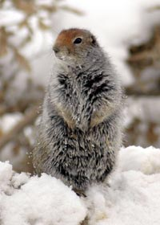

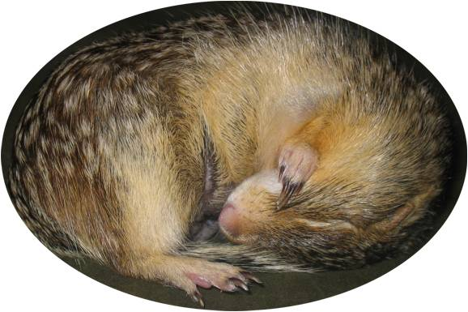
Physiology of hibernation in the ground squirrels.
Rebecca Herdman, Sam Johnson, Michael McGowan and Laura Stainsby.
School of Marine Science and Technology, Newcastle University, Newcastle Upon Tyne, United Kingdom
Introduction
Hibernation is used throughout the animal kingdom to allow survival under harsh conditions, in which food is scares. During hibernation animals undergo body temperature drops and reduced metabolism and oxygen consumption, in order to reduce energy consumption. Different species have different physiological adaptations, adapted to their environment. This article will look at the different physiological adaptations of ground squirrel species for hibernation.
Thermo-sensitivity in Ground Squirrels During Hibernation
Hibernation and torpor episodes in mammals such as the ground squirrels are governed by ecological processes within the body which are sensitive to external fluctuations in air temperatures. Due to seasonal changes, air temperatures decline when autumn and winter approach, which causes torpor bouts to lengthen due to a decrease in body temperature. This is a coping mechanism in order for the animal to remain in torpor allowing them to overcome extreme environmental changes and reductions in air temperature which ground squirrels would not be able to cope with otherwise. As torpor bouts increase due to decreasing air temperature, body temperature decrease with only a difference of 1.5 °C between the air and body temperature of the animal. This only occurs till a critical low air temperature is reached, around -2 °C, which causes the torpor bout and the body temperature to reduce but the difference in air and body temperature increases. This response of an amplification of heat production is important as it stops the animal’s body temperature from dropping below 1 °C which would be lethal to the animal [1]. Thus regulation of body temperature is essential in hibernating/torpid animals in order to survive seasonal changes in air temperature.
Torpor Bouts
Torpid ground squirrels arouse
periodically during hibernation.
The time between these arousals
increases as ambient
temperature drops and as
hibernation progresses they
Stabilize [2]. During these arousals
body temperature returns to
euthermic levels (Fig.1) and are
thought to be necessary to
restore depleted metabolites and
for removal of waste products, so why do they become longer as temperature drops? Studies show that with decreasing ambient temperature body temperature drops. This drop in body temperature is thought to reduce neural sensitivity to waste products allowing more to accumulate before the need for removal is registered [1].
Fig.1. Torpor bout length and body temperature throughout hibernation [2]
Fuel source/Switching fuel
Thirteen line ground squirrels entering hibernation increase production of certain proteins in the liver such as fatty acid binding proteins and transporters to support the metabolic fuel switch from proteins and carbohydrates to lipid and ketones. Amino-acid and nitrogen metabolism decreases, indicated by decrease in proteins involved [3]. This supports hypothesises that during hibernation proteins are preserved and re-synthesised to reduce nitrogen toxicity and preserve essential amino acids. Β-hydroxybutyrate (BHB) is an important fat derived ketone. BHB and other associated ketones play an important role in supplying fuel to the brain, heart and muscle and are found in higher concentrations, more so than glucose, during the hibernating season in ground squirrels [4].
Artic ground squirrel adaption's
Arctic ground squirrels have to cope with severely lower temperatures than all other ground squirrels. One adaptation is that they are larger than all other ground squirrels allowing them to store more fat and maintain a lower mass specific metabolic rate. Due to the severely low temperatures they have to be continuously thermogenic, this increases energy consumption during hibernation. For this reason arctic ground squirrels cannot alone survive on their fat stores. During preparation for hibernation it has been shown that Adrenal androgen levels can be 10-200 times higher than other hibernating animals. Adrenal androgens promote the buildup of muscle which provides protein that can be utilised without causing starvation [5].
References
[1]Geiser and Kenagy 1988, Physiol. Zool. 61:442-449
[2]Russell et al 2010, J. Comp. Physiol. B. 180:1165-1172
[3]Elaine et al 2010, Am. J. Physiol. Regul. Integr. Comp. Physiol. 298:329-340
[4]Andrews et al 2009, Am. J. Physiol Regul. Integr. Comp. Physiol.296:383-393
[5]Boonstra et al 2011, Functional Ecology 5:1348-1359

Slide 3

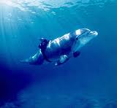

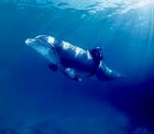
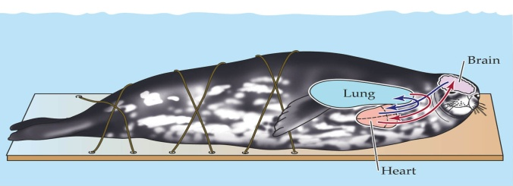
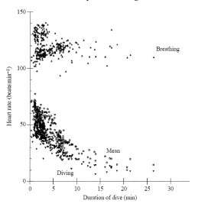
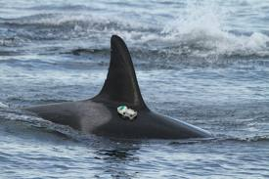
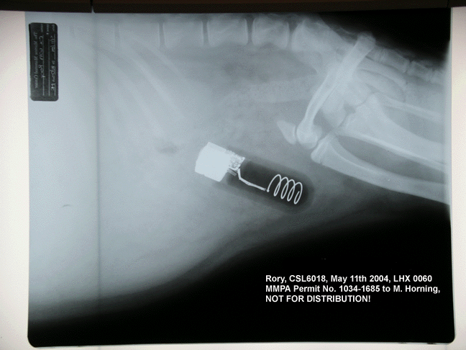
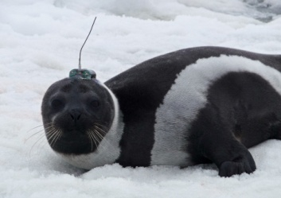
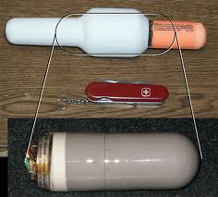
DEEP DIVING MAMMALS
Anna Chouler, Lucy Grable, Amy McIntosh, Juliet McKenna and Katie Tranter
INTRODUCTION
Newcastle University
CLASSIC DIVE RESPONSE
Marine mammals have developed many different responses to allow them to dive to different depths and durations this is called their ‘diving response’ (Cantu-Medellin et al. 2011). The dive response enables them to cope with reduced oxygen, pressure and changes to metabolic rate and temperature. Using energy to submerge makes their oxygen stores decline at a rapid rate, the oxygen rate then decreases at a slower rate for the rest of the dive, as does the metabolic rate. When all the oxygen is used up they switch to anaerobic metabolism. However, most mammals dive within their calculated aerobic dive limit (ADL). Their lungs are designed to collapse gradually with an increased hydrostatic pressure at depth. Air is pushed out the alveoli and into the upper part of the respiratory system, enabling them to dive deep (Williams 2007).
When the metabolic rates of eight captive grey seals was looked at, the mean diving metabolic rate (DMR) for adults and juveniles was 1.7 times the expected standard metabolic rate of terrestrial animals of the same size. The DMR was lower for all animals, than the rate of metabolism recorded when resting at the water’s surface (Sparling and Fedak 2004). Reduced temperature also comes with the decrease in metabolic rate.
It has been observed in bottlenose dolphins that the heat flow on the dorsal fin can drop by up to 35% and up to 24% on the flank and with the decrease in temperature their heart rate also slows down by up to 63.4% on dives up to 50m. When the dolphins return to the surface all levels return to normal (Williams 1999). The longest recorded dive time by was by an elephant seal for 120 minutes and the deepest dive was by a sperm whale at 2000 metres.
Pioneering work of Scholander, Irving and colleagues (Scholander 1940) led to the development of the fundamental foundations of the physiology of diving which includes the physiological responses to diving. Early experiments in which animals were forcibly submerged underwater found that this invoked several physiological responses including apnea (breathing stops), bradycardia (reduced cardiac output and therefore a reduced heart rate and a reduced volume of blood pumped) and peripheral vasoconstriction. This is associated with phyoperfusion of the peripheral tissues enabling mammals to survive for as long as possible on the oxygen stores within their bodies (Mottishaw et al. 1999).
These responses are known as the “dive reflex” or “classic dive response” and are used to save the limited oxygen for those tissues that are oxygen dependent e.g. tissues in the central nervous system. Experiments usually focus on recording dive heart rate as the response to diving as it is the easiest of the responses to record.
The Aerobic Dive Limit (ADL) was developed by Kooyman et al. (1980, 1983) and is the maximum amount of time that can be spent diving without a significant increase of lactate concentrations post-dive. This is calculated using the rate of oxygen consumption and the capacity to store oxygen within an animal during dives (Kooyman and Ponganis 1998).
PHYSIOLOGY
To help minimise energy expended during diving many marine mammals have a fusiform body shape. This shape tapers at either end with the middle of the body being much wider, helping to reduce drag whilst swimming and therefore reducing energy needed, allowing them to dive deeper within the same amount of time and using the same amount of energy (Fish and Hui 1991). The oxygen storing capability is clearly a major factor in the depth and duration of dives that marine mammals are capable of. One mechanism to increase the volume of oxygen stored is the adaptation of swimming muscles containing myoglobin. This oxygen storing protein allows oxygen to be stored in the muscles as well as in the blood, which has a high concentration of haemoglobin, allowing easy access to the oxygen during diving (Kooyman and Ponganis 1998). To cope with the large pressure experienced at deep depths, many diving mammals have adapted their lungs and chest cavities. The chest becomes much more flexible, allowing it to be compressed under pressure, and they have bronchial sphincters in their lungs, providing support to the lungs and preventing them from collapsing under high pressures (Wislocki and Belanger 1940).
Early marine mammal study. (Forced submission)
METHODOLOGIES
CASE STUDY
There are many different methods used to study deep diving mammals. It is often difficult to study them in their natural environment, as many species spend up to 90% of their time beneath the water (Costa 1993), and can dive to great depths. Early studies simply strapped marine mammals to boards and submerged them in a “forced dive,” whilst measuring their responses. This has improved with technology there are now many long range tags available which can be attached to the animals in their natural environment and can record information such as depth, dive time, dive profile, velocity, sound, acceleration data, body angle and position and even images (Johnson and Tyack 2003). This new ability to study the animals in the wild has given us a whole new understanding of many species as in the laboratory it is very difficult to simulate realistic “wild” conditions. Blood samples of the animals can also be taken before and after dives to monitor changes in blood composition (Hedrick and Duffield 1991). Laboratory work obviously still has its place, as it is obviously much easier to manipulate factors in the laboratory, giving us another level of understanding of these animals. For example, computer technology has been used to study carcasses of marine mammals to view lung compression at different simulated depths (Moore et al. 2011), and temperature has been manipulated to show the impact it has on the metabolic rate and energetic costs of sea lions (Liwanag et al. 2009).
A true Bradycadic example (Thomson and Fedak 1993):
The most extreme heart rate reductions have been
recorded during free diving by phocid seals
(Kooyman 1981). In general short dives only evoke
small responses whilst long dives evoke greater levels
of bradycardia. Grey seals show a true bradycardia
(Figure 1). Their heart rate drops substantially after
initially diving, with heart rates dropping to 4beatsmin⁻¹
for extended periods, despite the animal being able to
breathe freely. This extreme dive response is part of the
normal foraging behaviour. This species may be
consciously pre-setting its diving heart rate in
preparation of a known dive duration or the activity
pattern of the individual may be influencing the heart
rate.
The fact that there is a high percentage dive time and the animal has dive durations that exceed the estimated ADL implies that grey seals probably continue aerobic metabolism in most tissues throughout the dive. There may be cellular energy-saving mechanisms in place for long foraging dives. During these long dives, grey seals seem to avoid lactate build up by reducing their activity whilst submerged. Swimming
activity generally only took place during the descent and ascent stages of the dives and the species appeared to wait and ambush prey as opposed to searching and chasing it like Weddell seals.. This reduction in metabolic demand helps explain the extreme reduction in heart rate.
Figure 1. Heart rate while diving, during surface breathing periods and mean for complete dive/surface cycles (s) plotted against duration of dive. Taken from Thomson and Fedak (1993).
References:
Cantu-Medellin, N., Byrd, B., Hohn, A., Vázquez-Medina, J. P., Zenteno-Savín, T. 2011. Differential antioxidant protection in tissues from marine mammals with distinct diving capacities. Shallow/short vs. deep/long divers. Comparative Biochemistry and Physiology - Part A: Molecular & Integrative Physiology. 158(4):438-443.
Costa, D.P. 1993. The secret life of marine mammals. Novel tools for studying their behaviour at sea. Oceanography. 6(3): 120-128.
Fish, F. E. and Hui, C. A. 1991. Dolphin swimming – a review. Mammal review. 21(4):181-195.
Hedrick, M. S. and Duffield, D. 1991. Haematological and rheological characteristics of blood in seven marine mammal species: physiological implications for diving behaviour. Journal of zoology. 225(2):273-283.
Johnson, M. P. and Tyack, P. L. 2003. A digital acoustic recording tag for measuring the response of wild marine mammals to sound. Journal of Oceanographic engineering. 28(1):3-12.
Kooyman, G. 1981. Weddell Seal: Consummate Diver. Cambridge: Cambridge University Press. 135pp.
Kooyman, G. L. and Ponganis, P. J. 1998. The physiological basis of diving to depth. Birds and mammals. Annual Review of Physiology. 60: 19-32.
Kooyman, G. L., Wahrenbrock, E. A., Castellini, M. A. 1980. Aerobic and anaeirobic metabolism during voluntary diving in Weddell seals – evidence of preferred pathways from blood-chemistry and behavior. Journal of comparative physiology. 138: 335-346.
Kooyman G. L., Castellini M. A., Davis R. W. 1983. Aerobic dive limits of immature Weddell seals. Journal of comparative physiology. 151: 171-174.
Liwanag, H. E. M., Williams, T. M., Costa, D. P., Kanatous, S .B., Davis, R. B., Boyd, I. L. 2009. The effects of water temperature on the energetic costs of juvenile and adult California sea lions (Zalophus californianus): the importance of skeletal muscle thermogenesis for thermal balance. Journal of experimental biology. 212:3977-3984.
Moore, M. J., Hammar, T., Arruda, J., Cramer, S., Dennison, S., Montie, E., Fahlman, A. 2011. Hyperbaric computed tomographic measurement of lung compression in seals and dolphins.Journal of experimental biology. 214:2390-2397.
Mottishaw, P. D., Thornton, S. J., Hochachka, P. W. 1999. The Diving Response Mechanism and its Surprising Evolutionary Path in Seals and Sea Lions. American Zoologist. 39:434-450.
Science Daily. 2007. Why Diving Marine Mammals Resist Brain Damage From Low Oxygen. [online] Available at: http://www.sciencedaily.com/releases/2007/12/071218192033.htm [ Accessed 05/12/11].
Scholander, P. F. 1940. Experimental investigations on the respiratory function in diving mammals and birds. Hvalradets Skrifter. 22: 1-131.
Sparling, C. E. and Fedak, M. A. 2004. Metabolic rates of captive grey seals during voluntary diving. The Journal of Experimental Biology. 207:1615-1624.
Thomson, D. and Fedak, M. 1993. Cardiac responses of grey seals during diving at sea. Journal of experimental biology. 174:139-164.
Williams, T., Noren, D., Berry, P., Estes, J.A., Allison, C., Kirtland, J. 1999. The Diving Physiology of Bottlenose Dolphins (Tursiops Truncatus). The Journal of Experimental Biology. 202:2763–2769.
Wislocki, G. B. and Belanger, L. F. 1940. The lungs of the larger Cetacea compared with those of smaller species. 78:289-297.
Tag on a resident killer whale.
Life history tag in a Stellar sea lion
Tag on a Ribbon seal.
“Real size” of a life history tag.

Slide 4
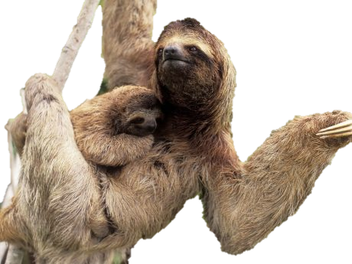
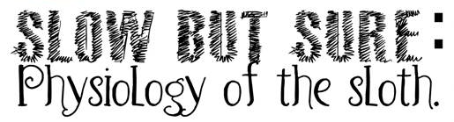
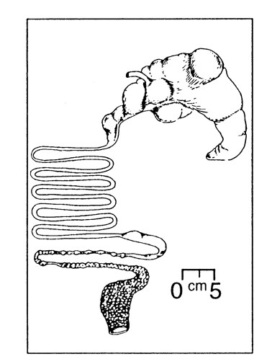
Lorron Bright, Bradley Budd, Lucy Emson, Janika Puska & Kayleigh Widdowson.
Flat heads, big eyes, short snout, tiny ears and long legs
2 distinct coats:
  Grows away from extremities and parts in middle to protect from weather when hanging upside down.
  Long, coarse coat – turns green in wet weather conditions from the ecosystem of algae and insects
  Short, fine coat – lays underneath
3 toed sloth have 9 vertebrae so neck can rotate 270 degrees.
Gilmore et al., 2010. Brazilian Journal of Medical and Biologic al Research 33:129-46.
Locomotion
Morphology
Sloths move so slowly as a result of their low calorie leaf based diet; not because they are simply lazy! Remarkable adaptations such as longer arms, short shoulder blades, a narrower chest and characteristic 2 or 3 toed feet make them perfect for a life upside down. The pectoral muscles are located at the end of the limb, as opposed to near the shoulder as in most other mammals (to allow them to constantly support their own body weight), other than this the exact same muscles involved in moving our limbs back and forth are used by sloths too. Sloths use diagonal couplet gaits to move forward and to increase speed simply increase step length and decrease the duration between contact and swing phases during motion (Nyakatura et al., 2010).
Nyakatura et al., 2010. Zoology 113(4):221-34.
Sloths are able to reproduce at any time during the year. Reproduction is between male and female sloth. The solitary life of the sloth is interrupted during this time; the male is and polygynous and leaves the female after mating occurs.
The gestation period is 150 days and birth occurs within the trees whilst the sloth is hanging upside down. There is usually only one young born per mating.
The female sloth cares for the young and the first month of the young’s life is spent hanging from the mother’s stomach. This is to hide the young from predators. At around 2 months of age the young begins to be weaned and follows the mothers diet. The mother and young stay together until it is around 8 months old, this is when the mother leaves the young and is solitary again.
Available at:: http://animals.jrank.org/pages/2739/Three-Toed-
Tree-Sloths-Bradypodidae-BEHAVIOR-REPRODUCTION.html [Accessed 12/12/2011] .
Available at:: http://www.amersol.edu.pe/ms/7th/7block/jungle_research/new_cards/12/report_12.html [Accessed 12/12/2011].
Available at:: http://animal.discovery.com/guides/mammals/habitat/tropforest/brownsloth.html Last accessed 12/12/2011.
Reproduction
Thermoregulation
Sloths have very variable body temperatures .
Thermoregulation maintained by basking in the sun or sheltering in the shade.
Studies have found sloths adopt different postures depending on the weather. In sunny conditions, sloths usually adopt extended postures to maximise surface area solar radiation exposure.
In cooler weather, sloths tend to adopt huddles postures which minimizes heat loss but still maintains intermediate exposure to solar radiation.
Exposure to solar radiation is essential as it raises body temperature which then increases the action of the gut bacteria.
Urbani.B and Bosque (2007) Mammalian Biology, 72 (6), 321-329 .
Sloths diet consists predominately of leaves; individual sloths show a preference for leaves obtained from the trees that their mothers ate from during the first six months of life.
The rate of passage and fermentation process is slow, (2.5 days to pass 5% of ingesta) .
Low metabolic rate may help to reduce
the absorption of toxic substances in some leaves.
Slow rate of fermentation in stomach;
thought to be due to low body temperature.
The upright posture adopted during rest is thought to be an adaptation, to exploit the stratification of digesta within the forestomach and using gravity to aid them in selectively passing larger particles.
Sloth’s do not possess a cecum this may be compensated by enzyme activity in the stomach.
Clauss.M. (2004) Mammal Review. 34, 241-145 .
Gilmore. D.P et al. (2001) Brazilian Journal of Medical and Biological Research. 34, 9-25.
The main predators of sloths are the jaguar, snakes and the eagle
A sloths claws are its only natural defence
The algae that grows within the fur of the sloth imparts a green colour to the coat providing camouflage
Sloths are critically endangered and face a very high risk of extinction in the immediate future
Their slow movement within the trees attracts very little attention, lessening the chance of eagle or human hunter contact
Sloths only move in the night hours increasing their stealth
Return to the ground to defecate as it would attract predator attention, as it would attract attention carrying out these actions from high in the trees
Available: http://www.treehugger.com/natural-sciences/sloths-more-vulnerable-to-predators-than-previously-thought.html. Last accessed 12/12/2011
Figure 1. http://onlinelibrary.wiley.com/doi/10.1111/j.1365-2907.2004.00039.x/pdf
Digestion
Defence

